Slide 1
Notes:
1. Craft a clear and descriptive title
Your article’s title is the first thing readers and search engines see. A well-crafted title:
includes key terms: Incorporate important keywords early in the title.
is specific: A specific title is more likely to rank well in search results and attract the right audience.
avoids jargon: Make the title understandable for a broad audience to increase its reach.
keep it short: Consider moving a longer phrase from your title to the first sentence of your abstract to keep your title concise keeping it between 8-10 words.
don't use clickbait tactics: These tactics don’t work for SEO!
Multiplex histology
rare innate lymphoid cells
Tissue niches
2. Choose relevant and specific keywords
Keywords are the terms and phrases that potential readers might use when searching for content related to your research. To optimize your article:
identify keywords: Think about the main topics and concepts of your research. What terms would others use to find work like yours? Who is your audience? What fields are they working in? What language do they use?
use tools: Tools like Google Keyword Planner, Google Trends, or academic databases can help you identify popular keywords in your field.
include keywords: Place your keywords in key areas such as the title, abstract, and headings. However, ensure they are integrated naturally to maintain the readability and flow of your content.
keep it natural: Avoid keyword stuffing, as overuse can lead to search engines lowering your article’s ranking.

Slide 2
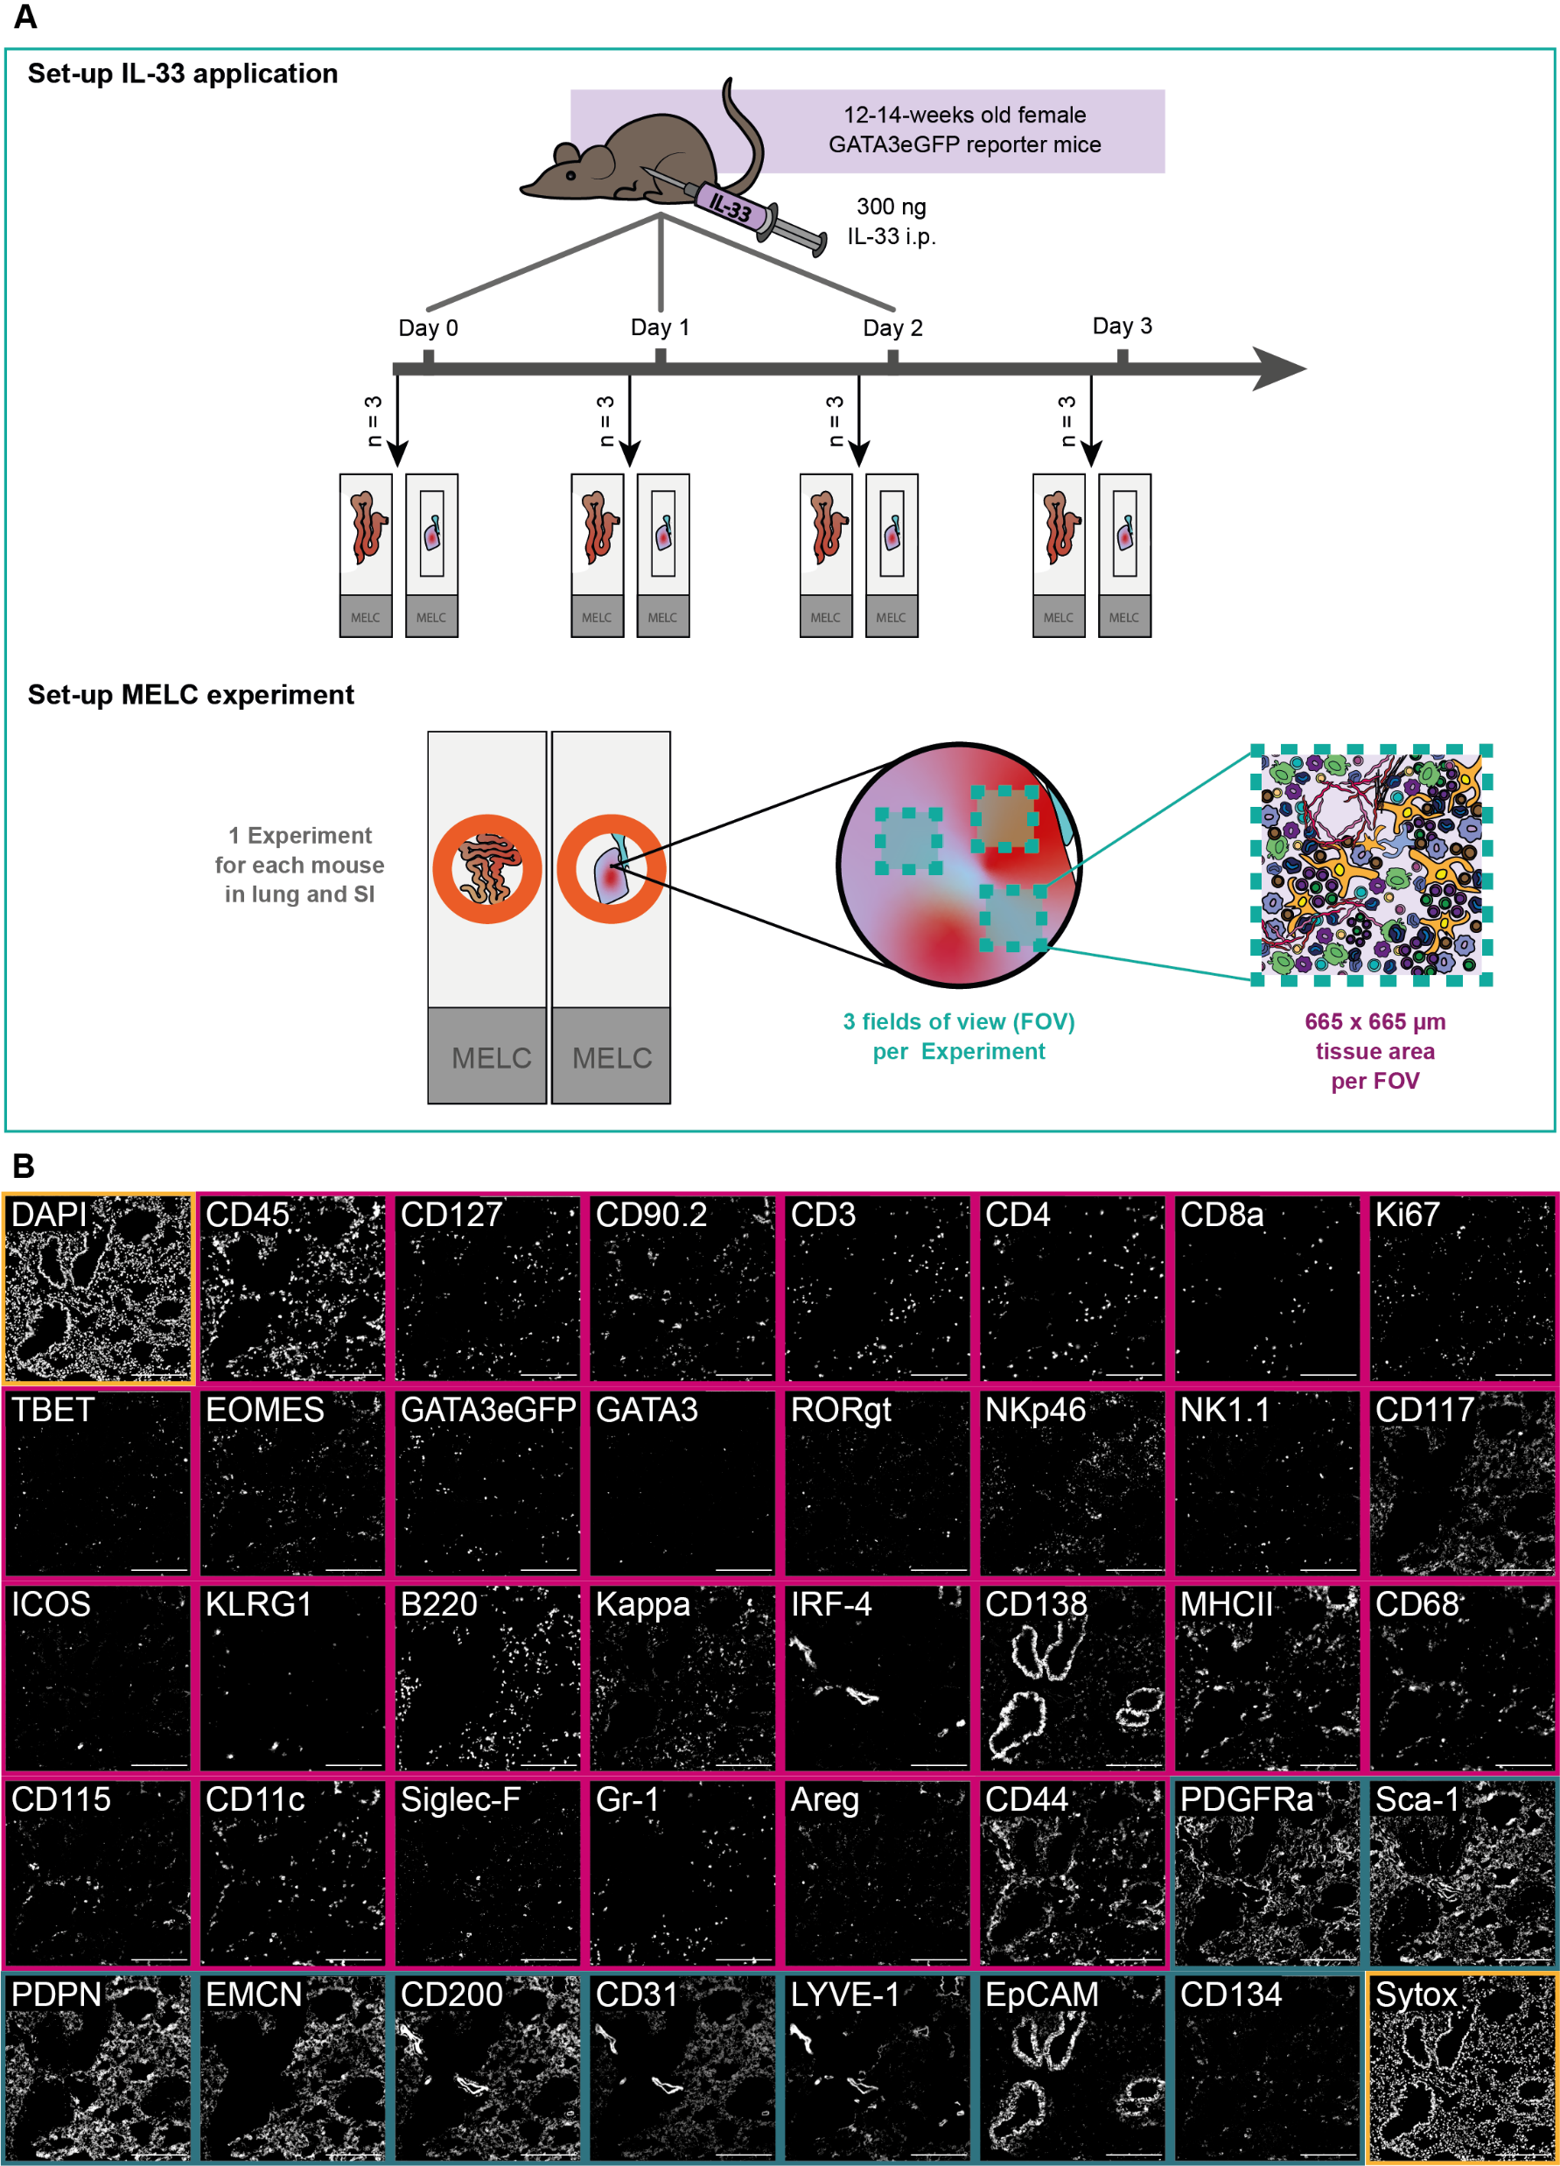
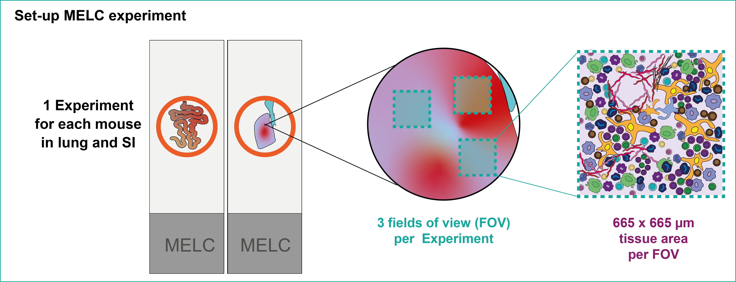
Figure 1: Combining cyclic IF with a systemic inflammation model in murine lung and SI tissues to study ILC niches.
Figure 1: (A) Schematic of the experimental set-up of the IL-33 systemic inflammation model and the MELC experiment. In short, 12-14-week-old GATA3eGFP reporter mice were i.p. injected with 300 ng IL-33 on up to 3 consecutive days. 24 h after the last dose, organs were harvested and processed for cyclic IF (MELC). In each MELC experiment, three regions of interest (fields of view = FOV) were acquired, each measuring 665 x 665 µm. (B) Overview of an established 40-marker panel in an exemplary tissue region of murine lung. Each image shows the same tissue region stained for diverse immune markers (magenta) and structural markers (darkcyan), as well as nuclei stains (yellow). Scale bar represents 200 µm.

Slide 3
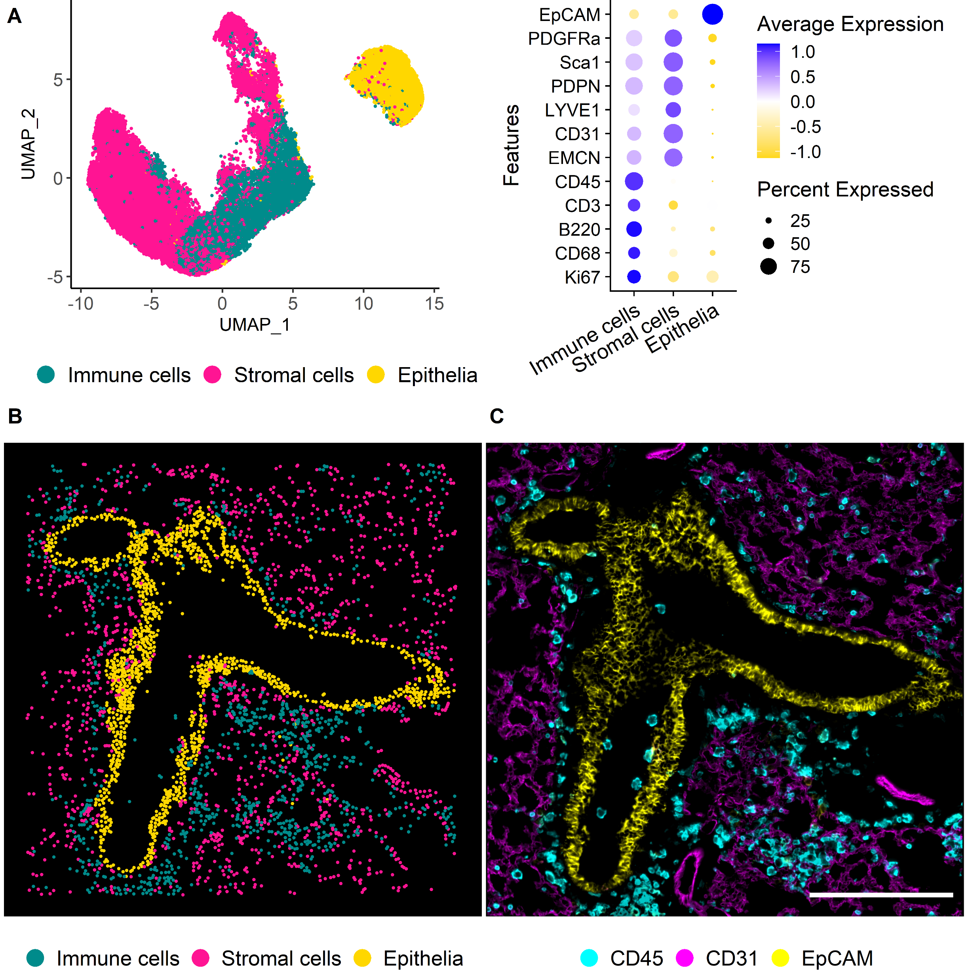
Figure 2: Immune and non-immune cells are annotated from cyclic IF using the Seurat workflow.
Figure 2: (A) UMAP representation of the first level of annotation (AL1) in murine lung tissue showing the three clusters annotated as Immune cells, stromal cells, and epithelia based on the feature profiles shown in the dot plot beside. (B) Annotated clusters of AL1 mapped in X and Y. Annotations are colored by cell type with immune cells (Cyan), vessels (Magenta), and epithelia (Yellow). (C) IF overlay of CD45 (Cyan), CD31 (Magenta), and EpCAM (Yellow) of the same FOV shown in B. Scale bar: 200 µm.
Notes:
Maybe add the second level of annotation as well to show the nice annotation of immune cell types in the ILF? Or put in a supplementary figure?

Slide 4
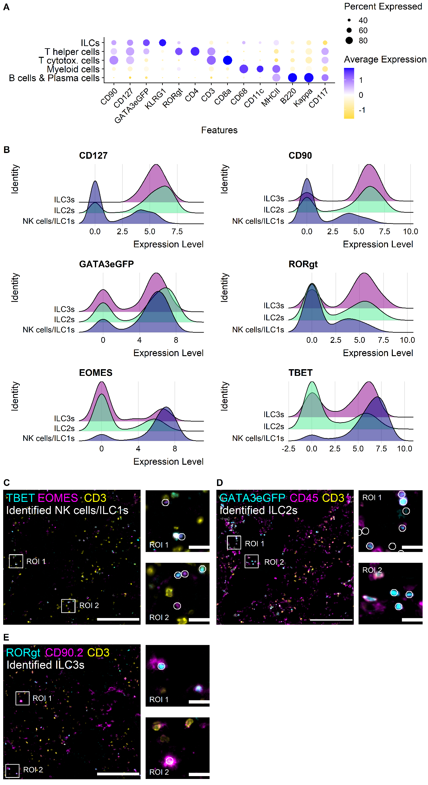
Figure 3: Three ILC subtypes are resolved and ILC2s represent the predominant subtype in murine lung tissue.
Figure 3: (A) Dot plot showing the marker profiles of the annotated immune cell types in murine lung including ILCs. (B) Ridge plots of ILC-related markers showing the levels for the identified ILC subsets in murine lung NK cells/ILCs, ILC2s, and ILC3s. (C) Visual validation NK cells/ILC1s. Cells are depicted on IF overlay of TBET (Cyan), EOMES (Magenta), CD3 (Yellow). (D) Visual validation of ILC2s. Cells are overlayed with GATA3eGFP (Cyan), CD45 (Magenta), and CD3 (Yellow). (E) Visual validation of identified ILC3s. Cells annotated as ILC3s are depicted on IF overlay showing RORgt (Cyan), CD90.2 (Magenta) and CD3 (Yellow). (D-E) Identified cells are depicted as white circles, each circle representing one cell. White boxed mark regions of interest that are zoomed in respectively on the right side. Scale bars represent 200 µm in overviews, and 20 µm in ROIs.

Slide 5
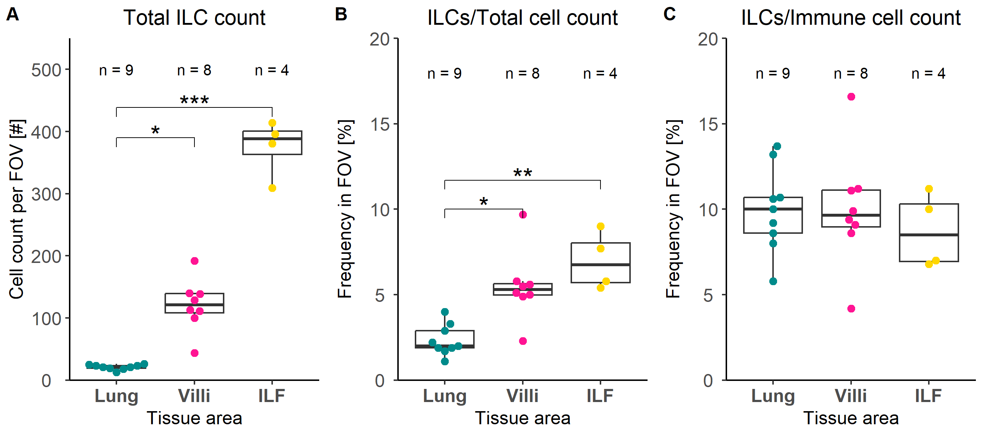
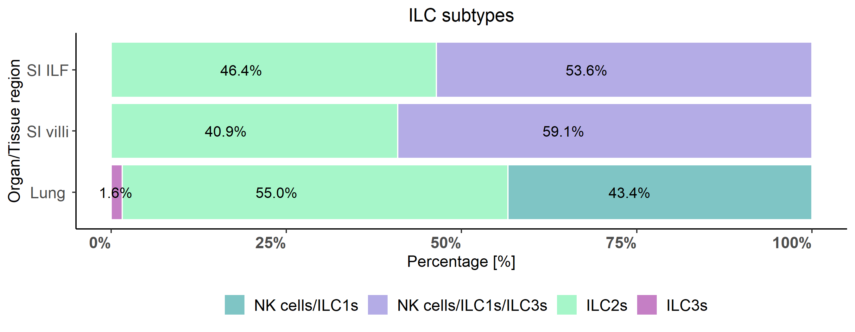
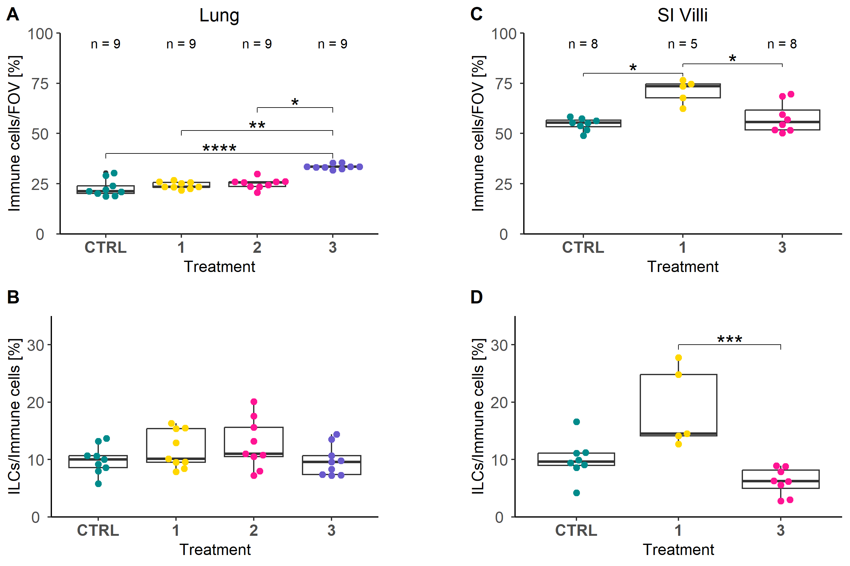
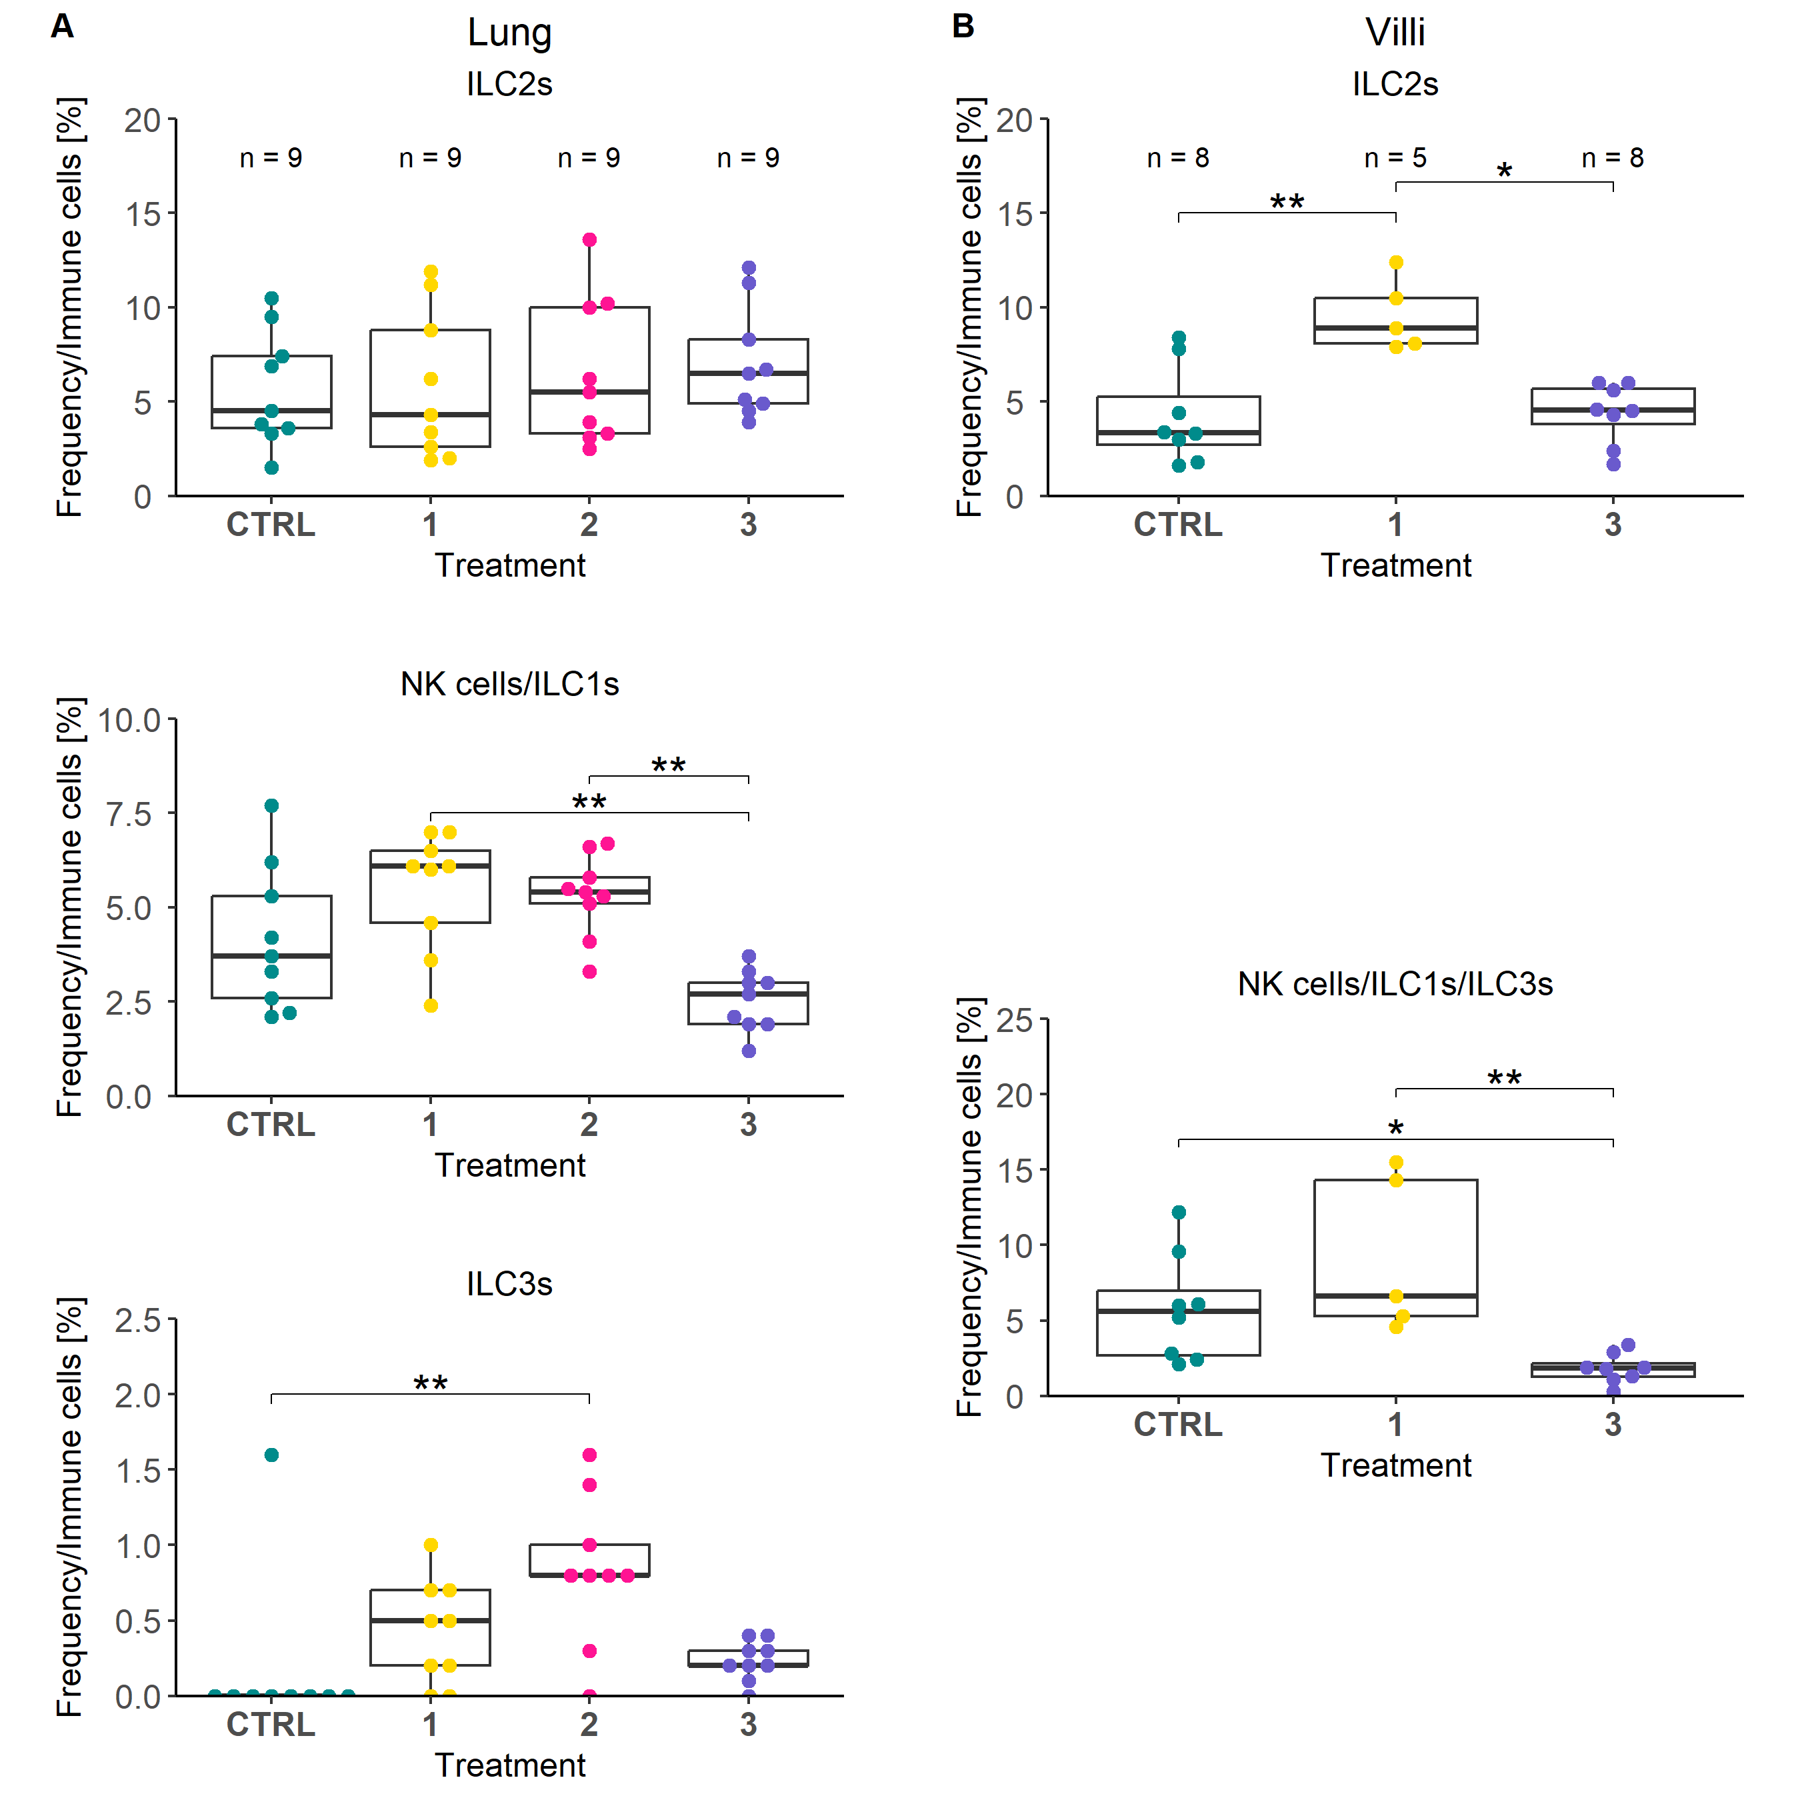
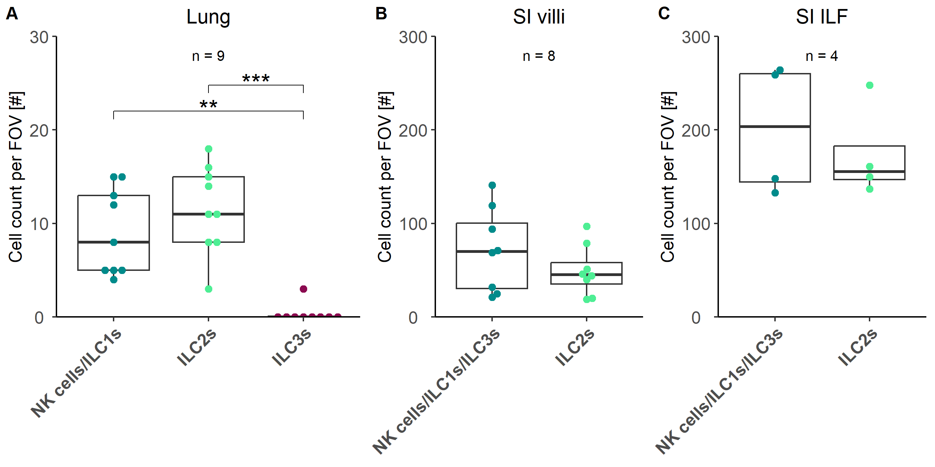
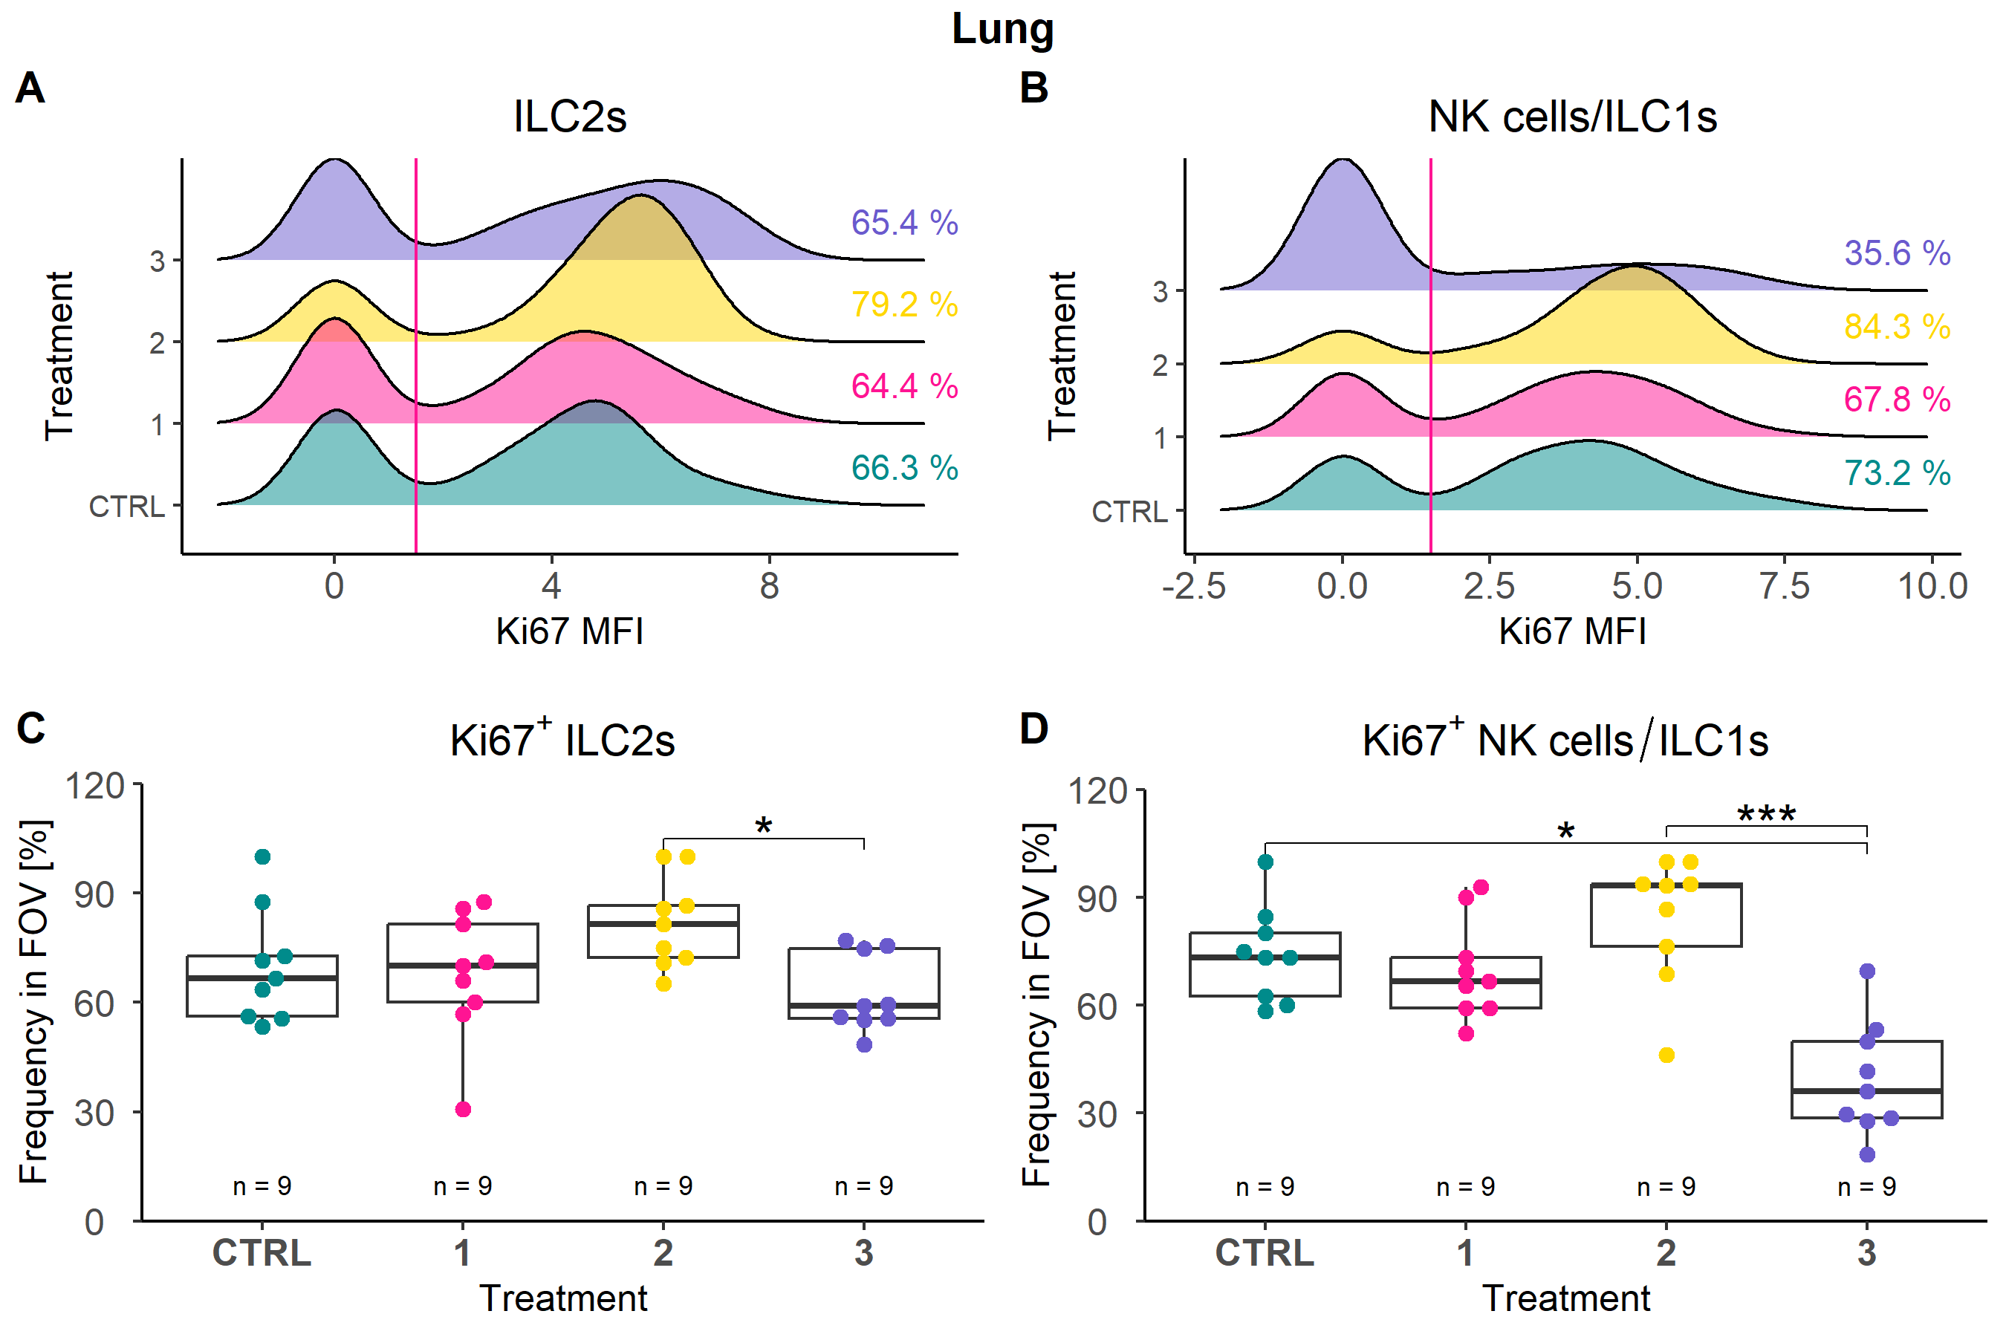
Figure 5: lung ILC2s only increase at IL-33 day 3.
Figure 5: (A) Boxplots depicting the cell count per field of view (FOV), ILC frequency of total cells, and ILC frequency within the immune cell compartment for each analyzed tissue type, namely lung, SI villi, SI ILF. (B) Stacked bar plot showing the proportion of the identified ILC subtypes within all identified ILCs of the analyzed tissue types lung, SI villi, and SI ILF. (C) Box plots visualizing the frequency of immune cells per FOV in lung and SI villi regions per condition time point, as well as the frequency of ILCs within the immune compartment. (D) Box plots depicting ILC frequencies at different condition time points in lung and SI villi. (E) Ridge plots visualizing the mean fluorescence intensity of Ki67 for lung ILC2s and NK cells/ILC1s. Box plots visualizing the frequency of the Ki67+ subset of lung ILC2s and NK cells/ILC1s. Each dot represents one analyzed FOV and is depicted as n at the top of each bar.
Notes:
Quantification of ILCs

Slide 6
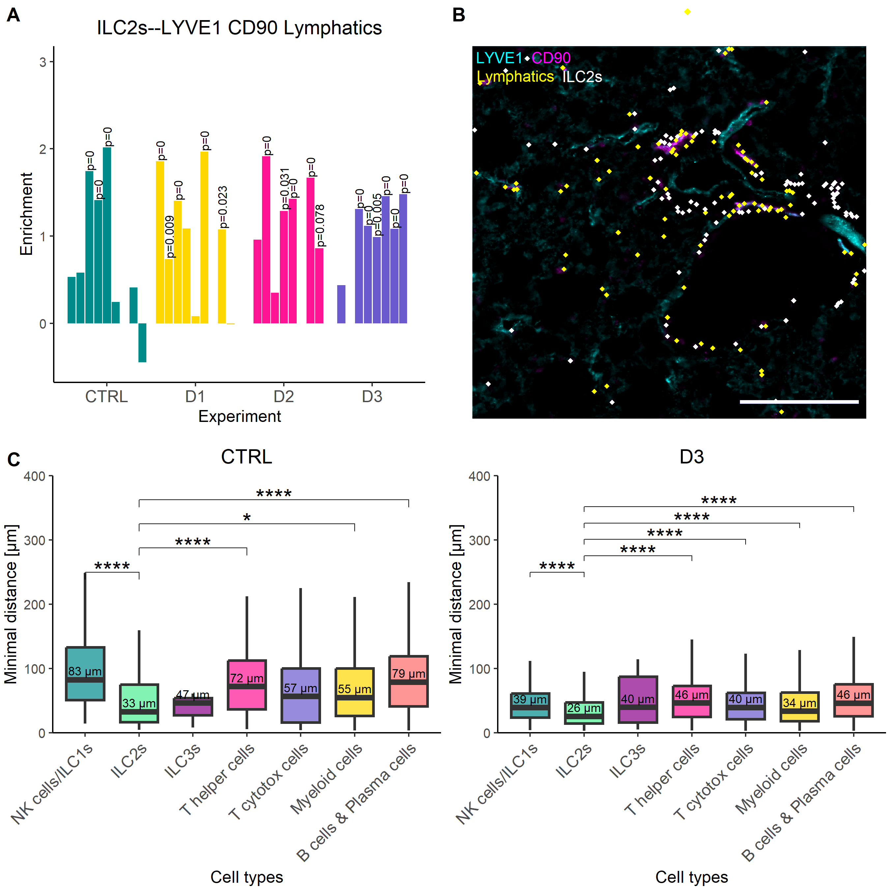
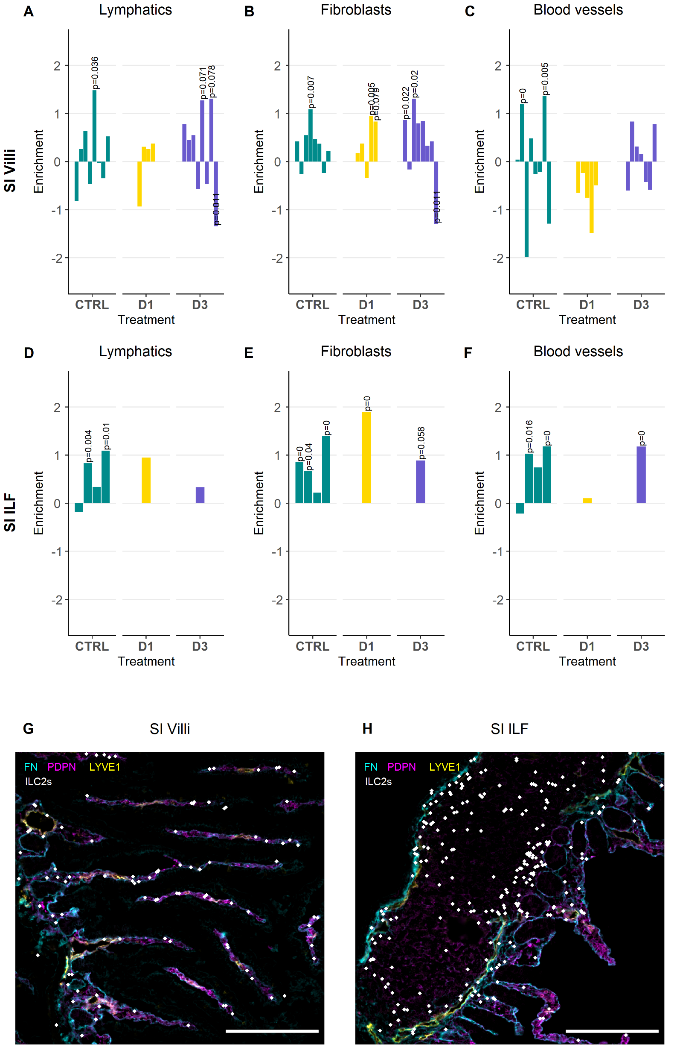
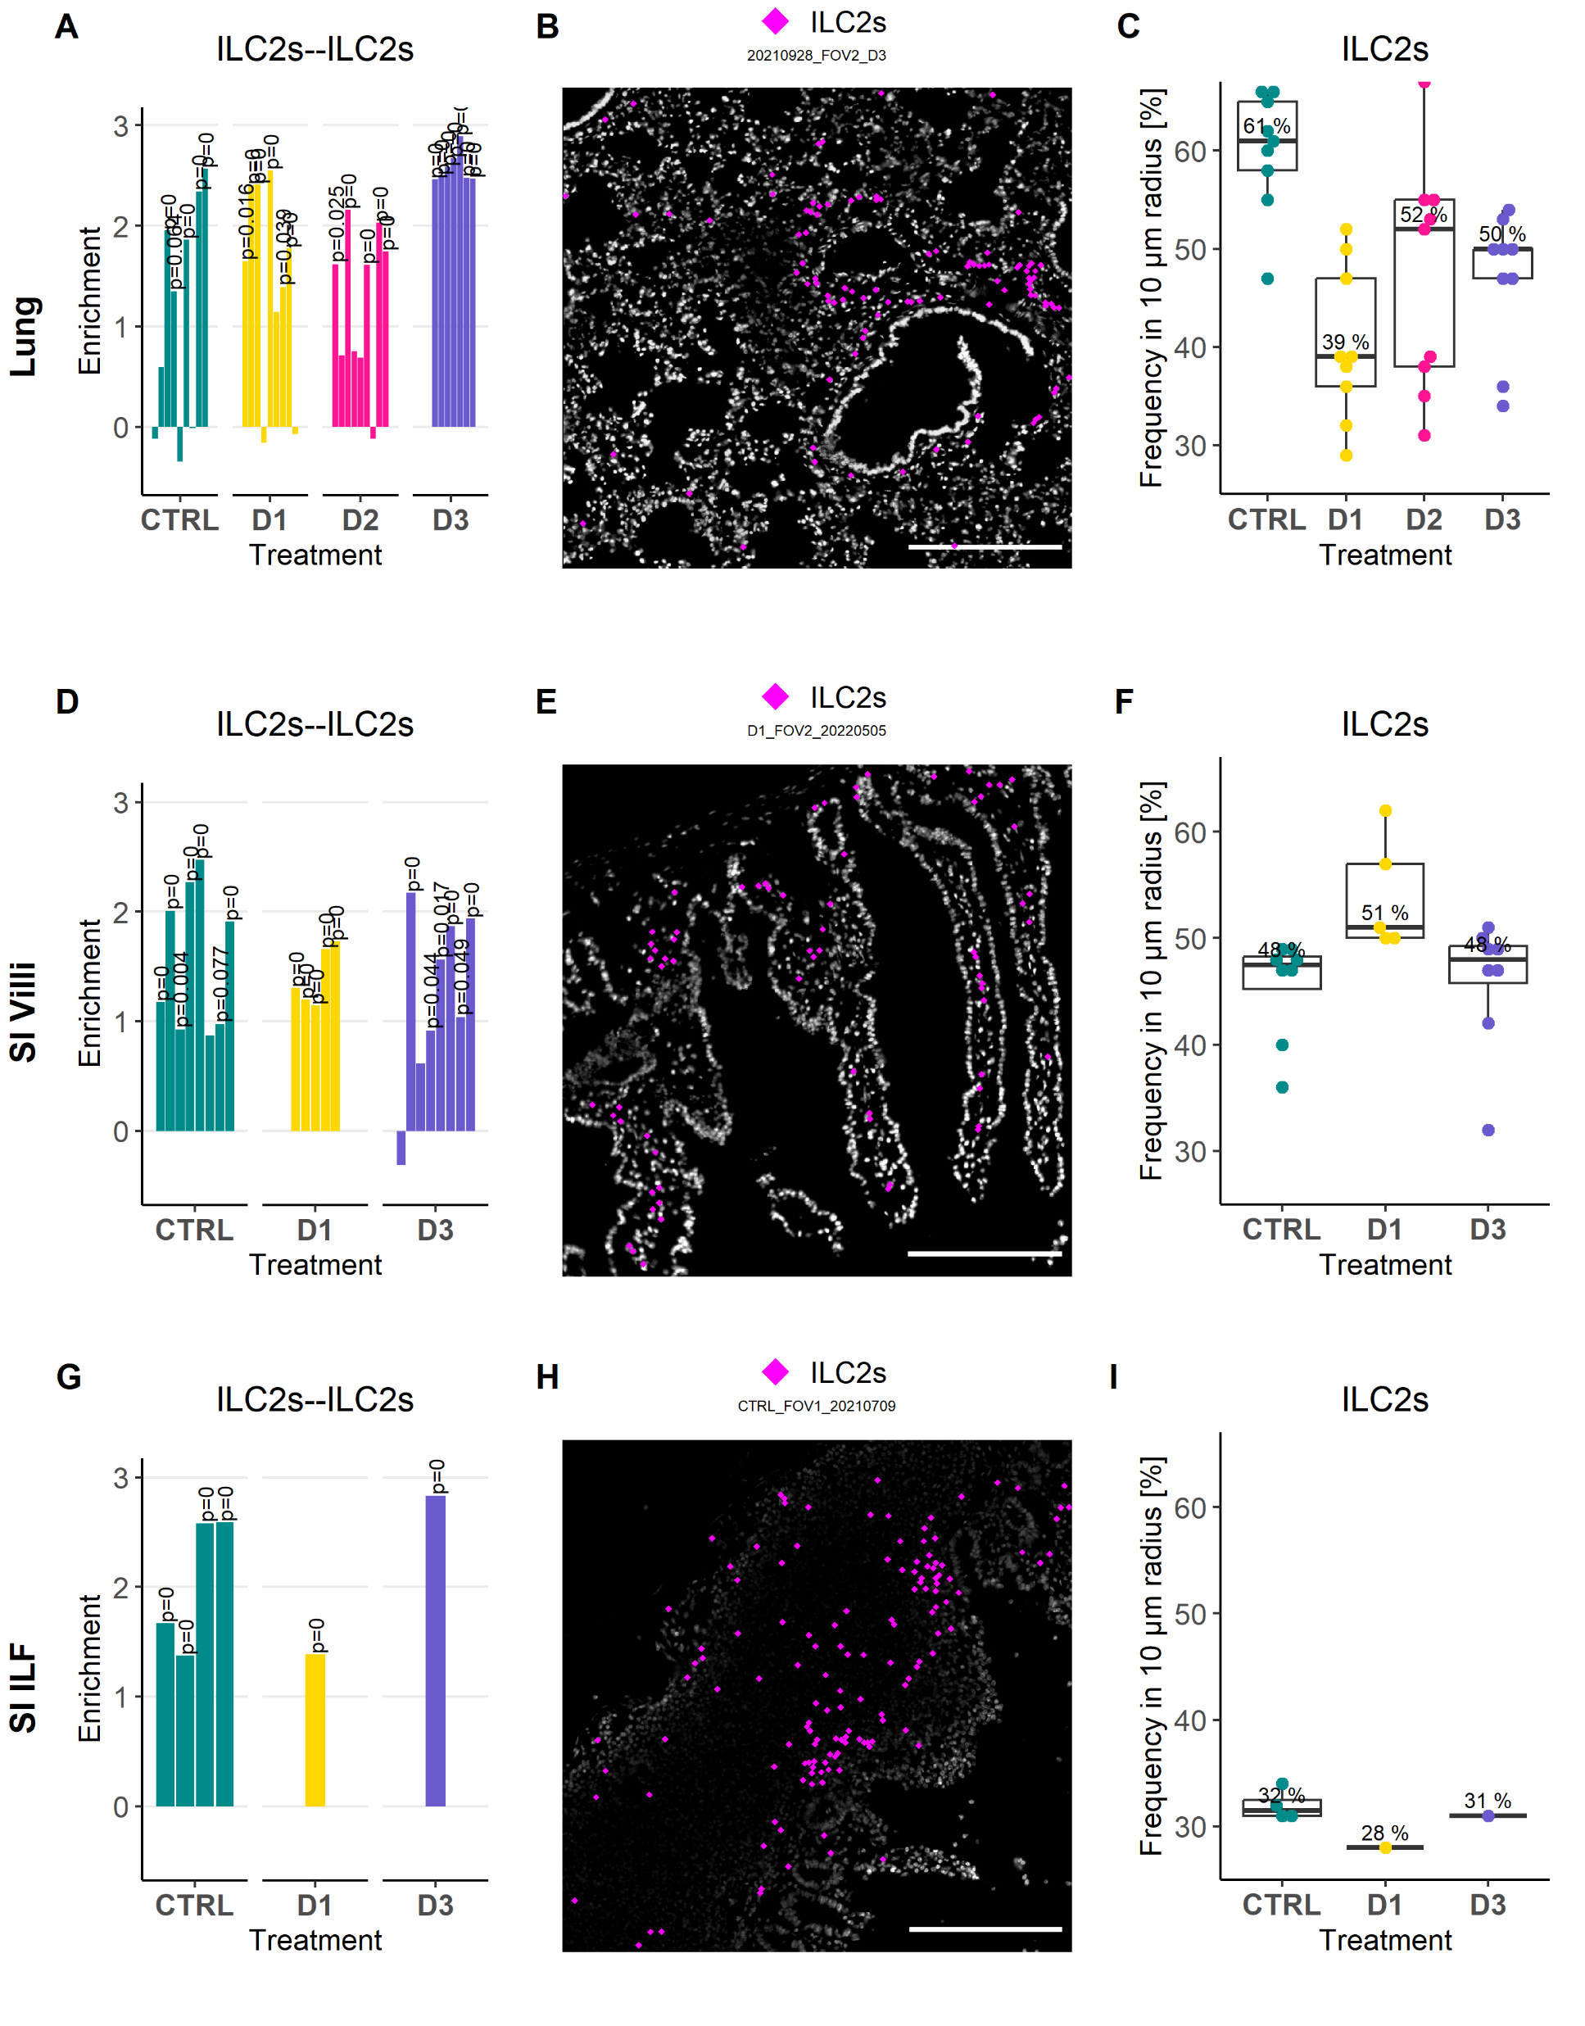
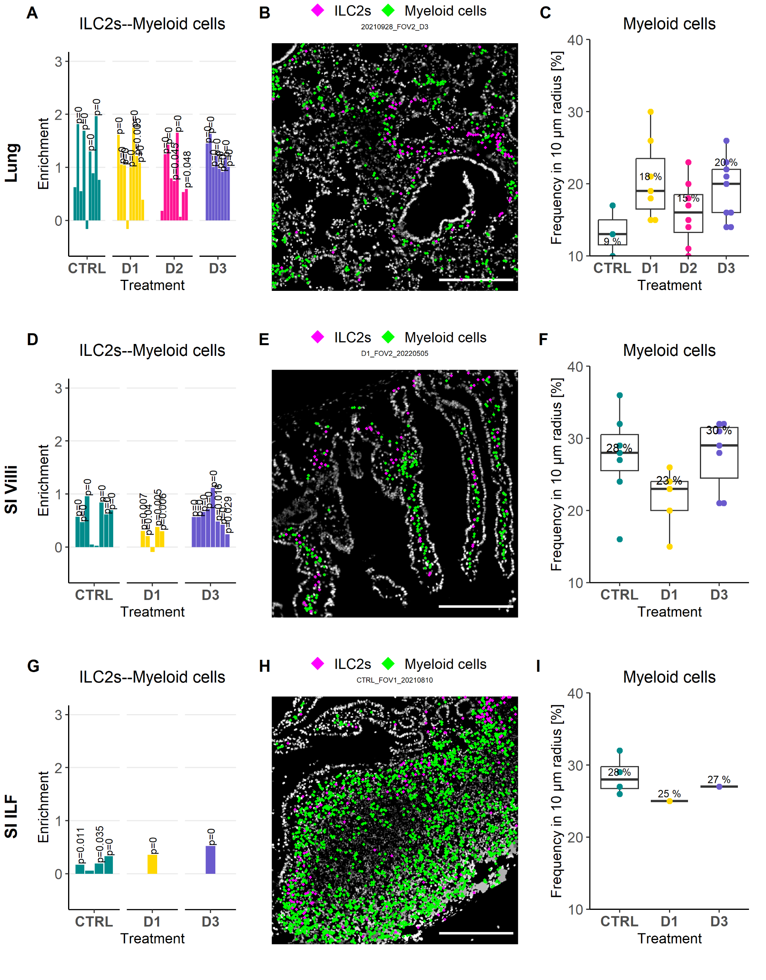
Figure 6: Spatial analysis reveals accumulation of ILC2s in peri-lymphatic niches shared with myeloid cells in lung and SI.
Figure 6: (A) Bar plot depicts co-enrichment analysis of lung ILC2s and lymphatics. (B) IF overlay of markers for lymphatic endothelial cells LYVE1 (Cyan) and CD90.2 (Magenta) are shown together with analyzed ILC2s (White dots) and lymphatics (Yellow dots) in an exemplary tissue region in the lung at IL-33 day 2. (C) Box plots showing the minimal distance in µm of different identified immune cell types to lymphatics under homeostatic conditions (CTRL, left) and after 3 doses of IL-33 (D3, right). (D) Bar plot showing the results of the co-enrichment analysis of ILC2s with lymphatics and fibroblasts in SI villi and SI ILF tissue regions. (E) IF overlays of FN (Cyan), PDPN (Magenta), and LYVE1 (Yellow) depicted with identified ILC2s (White dots) in SI villi (left) and SI ILF (right) exemplary tissue regions. (F) Bar plot showing the co-enrichment scores of ILC2s and ILC2s in lung, SI villi and SI ILF tissue regions. (G) Boxplots depicting the frequency of ILC2s in a 10 µm radius around ILC2s in lung, SI villi and SI ILF tissue regions. (H) Bar plot showing the co-enrichment scores of ILC2s and myeloid cells in lung, SI villi and SI ILF tissue regions. (I) Boxplots depicting the frequency of myeloid cells in a 10 µm radius around ILC2s in lung, SI villi and SI ILF tissue regions. In bar plots, each bar represents one analyzed field of view (FOV). In IF overlays, scale bar represents 200 µm.

Slide 7
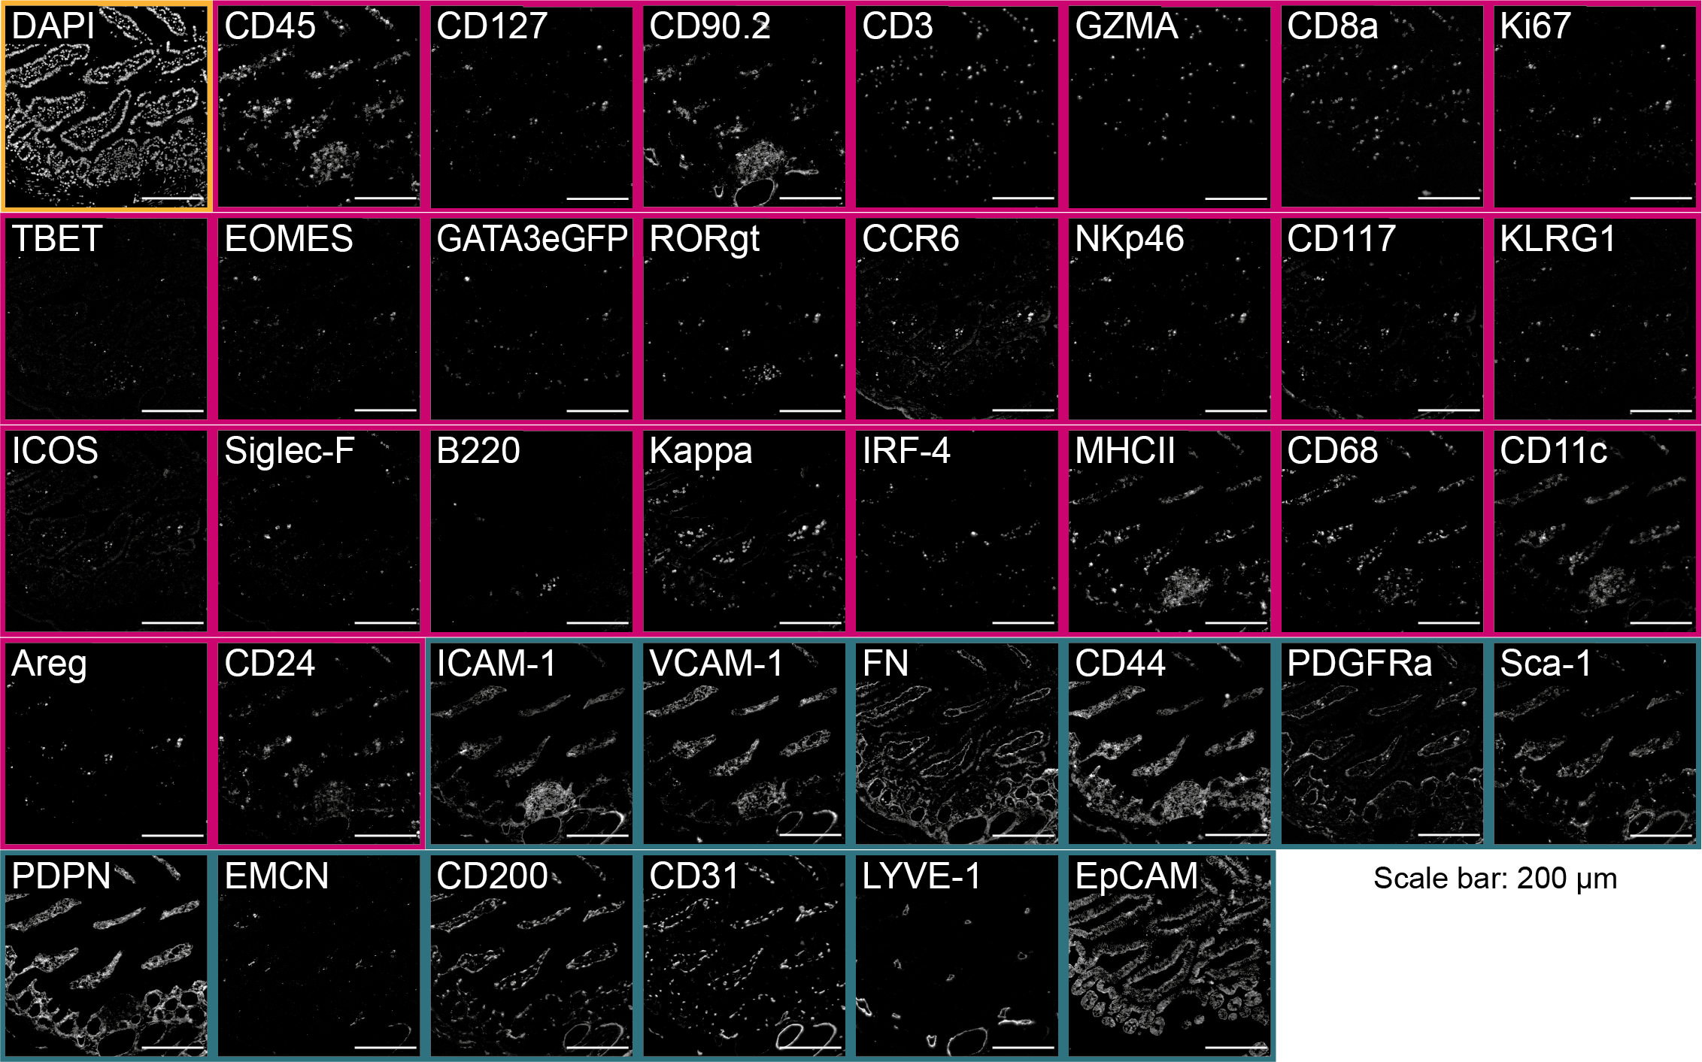
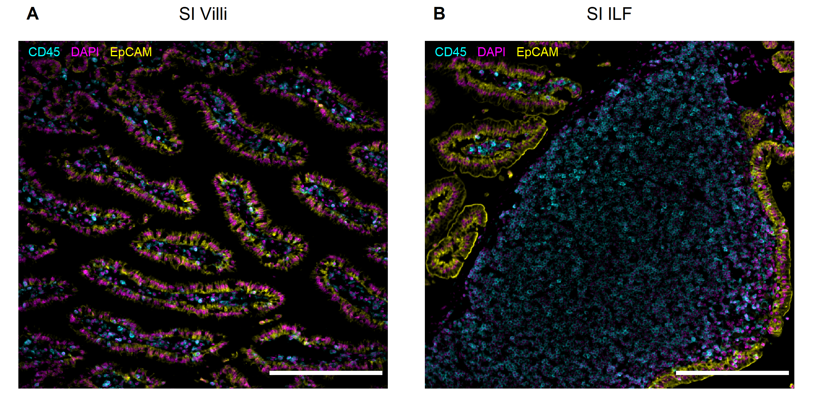
Suppl. Figure 1:
Suppl. Figure 1: (A) Overview of an established 38-marker panel in an exemplary tissue region of murine small intestine. Each image shows the same tissue region stained for diverse immune markers (magenta) and structural markers (darkcyan), as well as the nuclei stain DAPI (yellow). (B) IF overlays of the pan-immune marker CD45 (Cyan), the nuclear stain DAPI (Magenta), and the epithelial marler EpCAM (Yellow) acquired by MELC in the small intestine. Small intestinal tissue regions were categorized into SI villi and SI ILF based on the predominant tissue structures visible in the acquired images. Scale bar represents 200 µm.

Slide 8
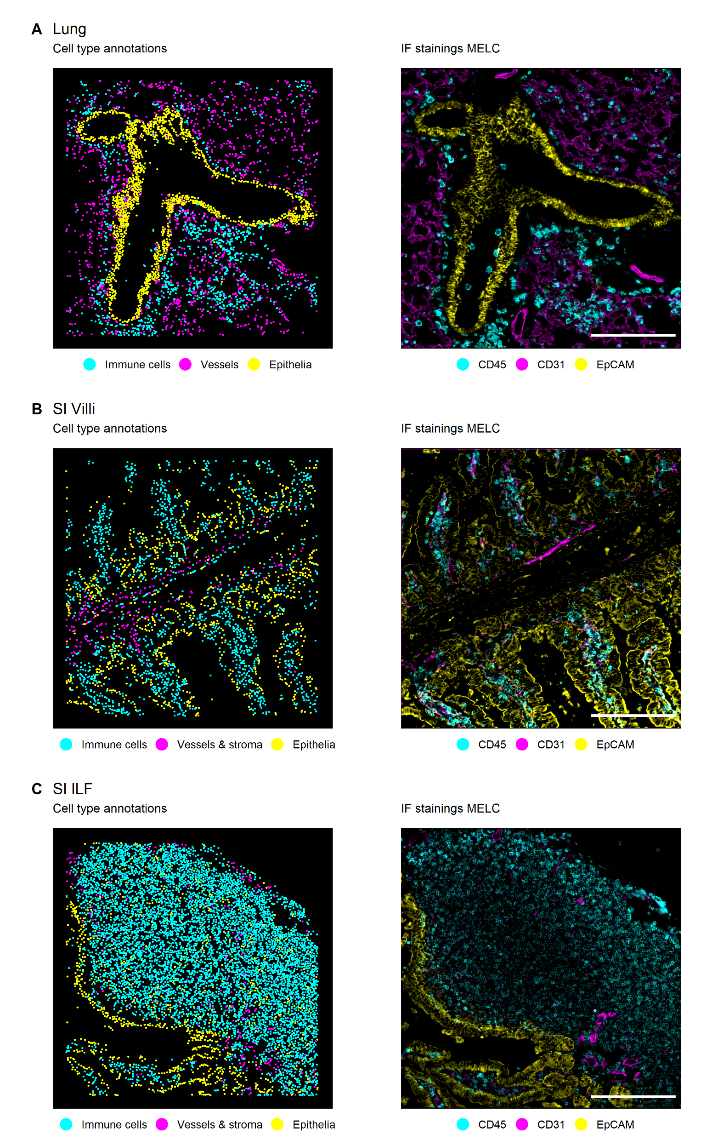
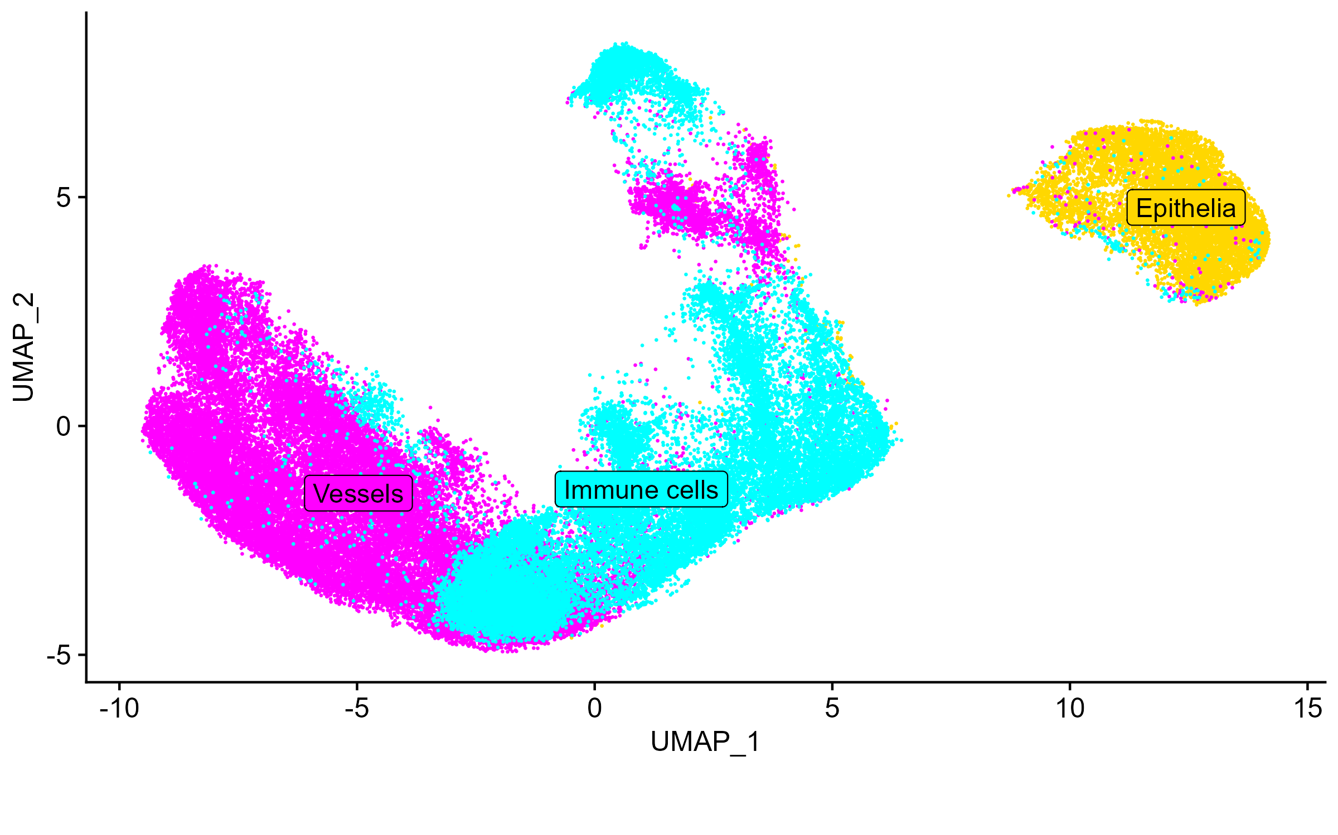
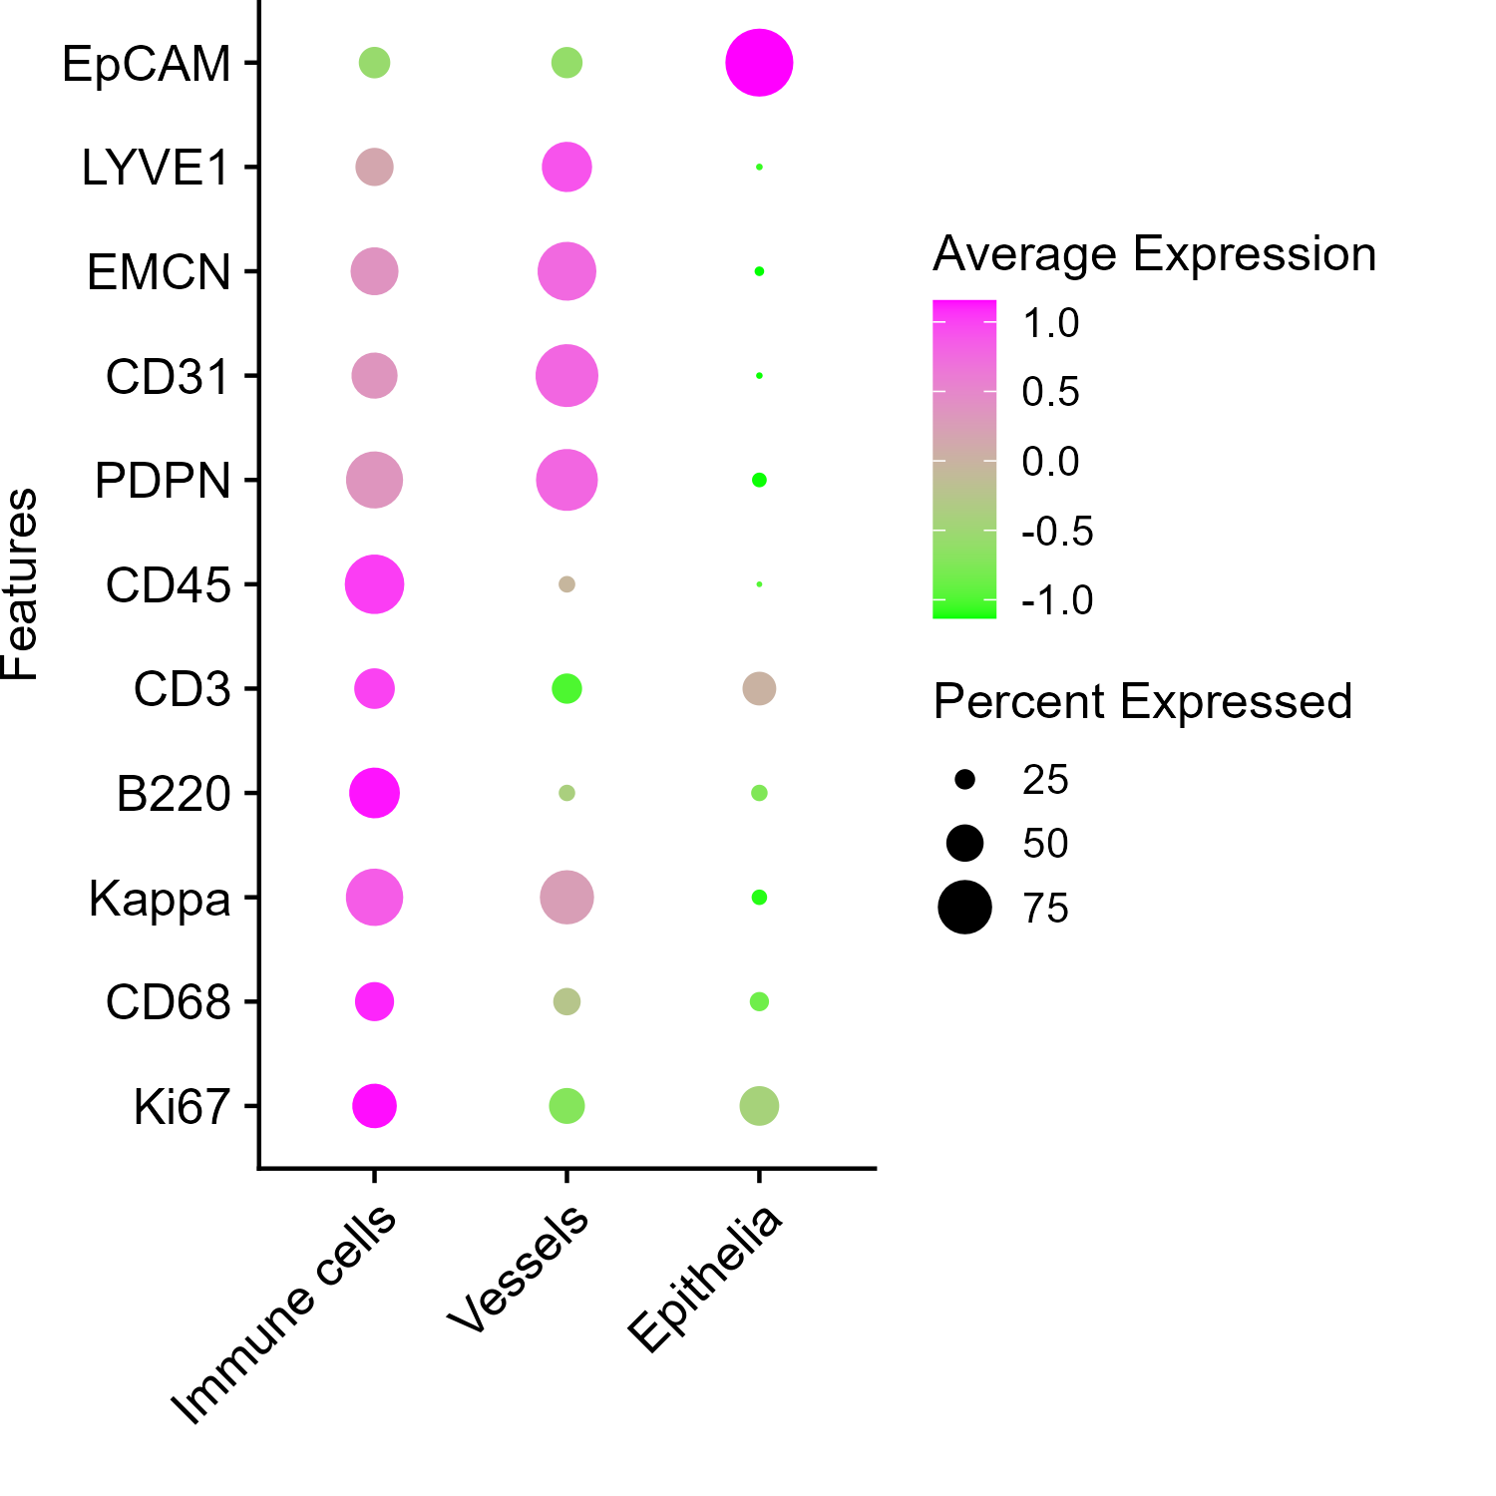
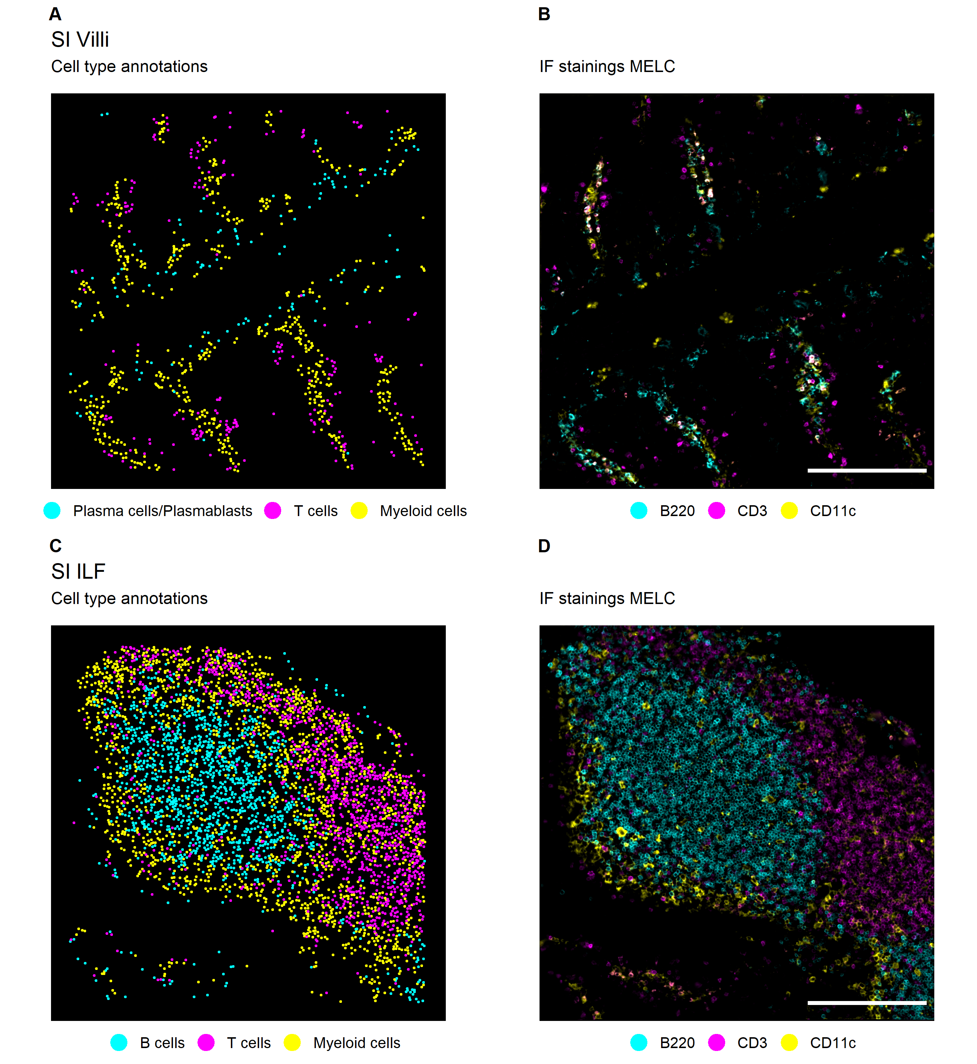
Figure 2: Major and rare immune and non-immune cells are annotated from cyclic IF using the Seurat workflow.
Figure 2: (A) UMAP representation of the first level of annotation (AL1) in murine lung tissue showing the three clusters annotated as Immune cells, vessels, and epithelia based on the feature profiles shown in the dot plot below. (B) Annotated clusters of AL1 mapped in X and Y next to the respective immunofluorescence (IF) overlay of correlating marker stainings for a representative field of view (FOV) of lung (upper panel), SI villi (middle panel), and SI ILF (lower panel). Annotations are colored by cell type with immune cells (Cyan), vessels (Magenta), and epithelia (Yellow), and correlate with CD45 (Cyan), CD31 (Magenta), and EpCAM (Yellow).
Notes:
Maybe add the second level of annotation as well to show the nice annotation of immune cell types in the ILF? Or put in a supplementary figure?

Slide 9
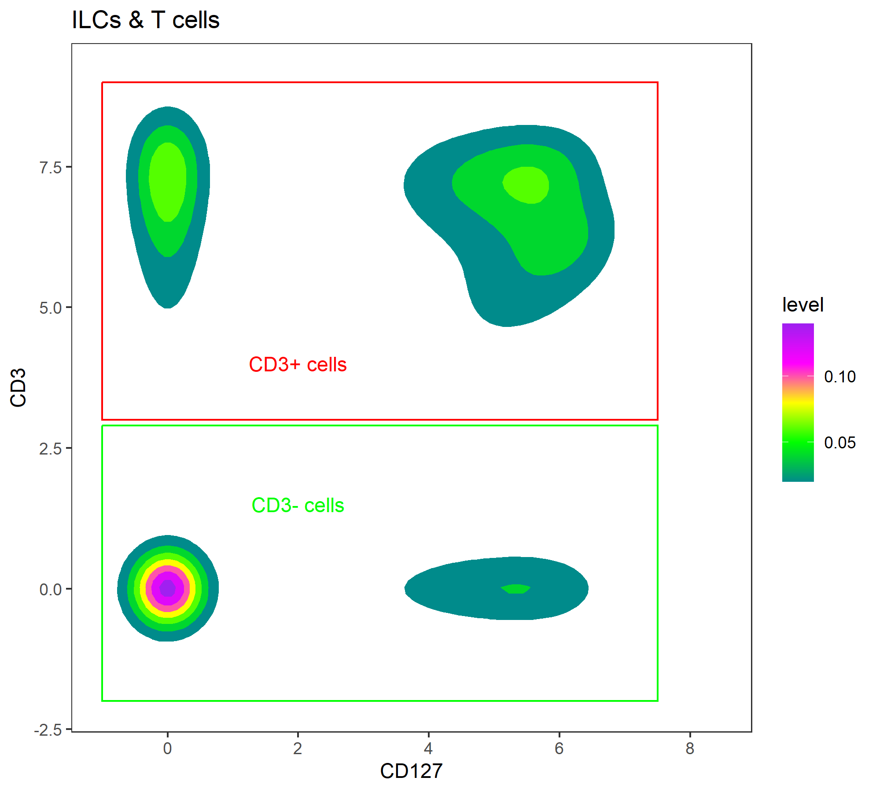
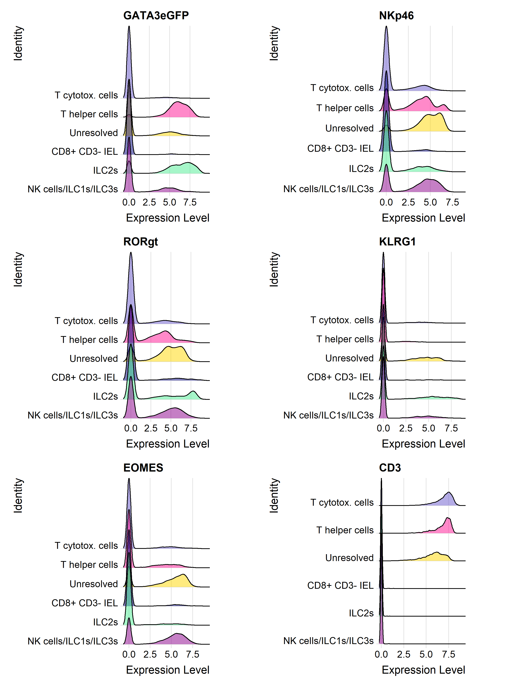
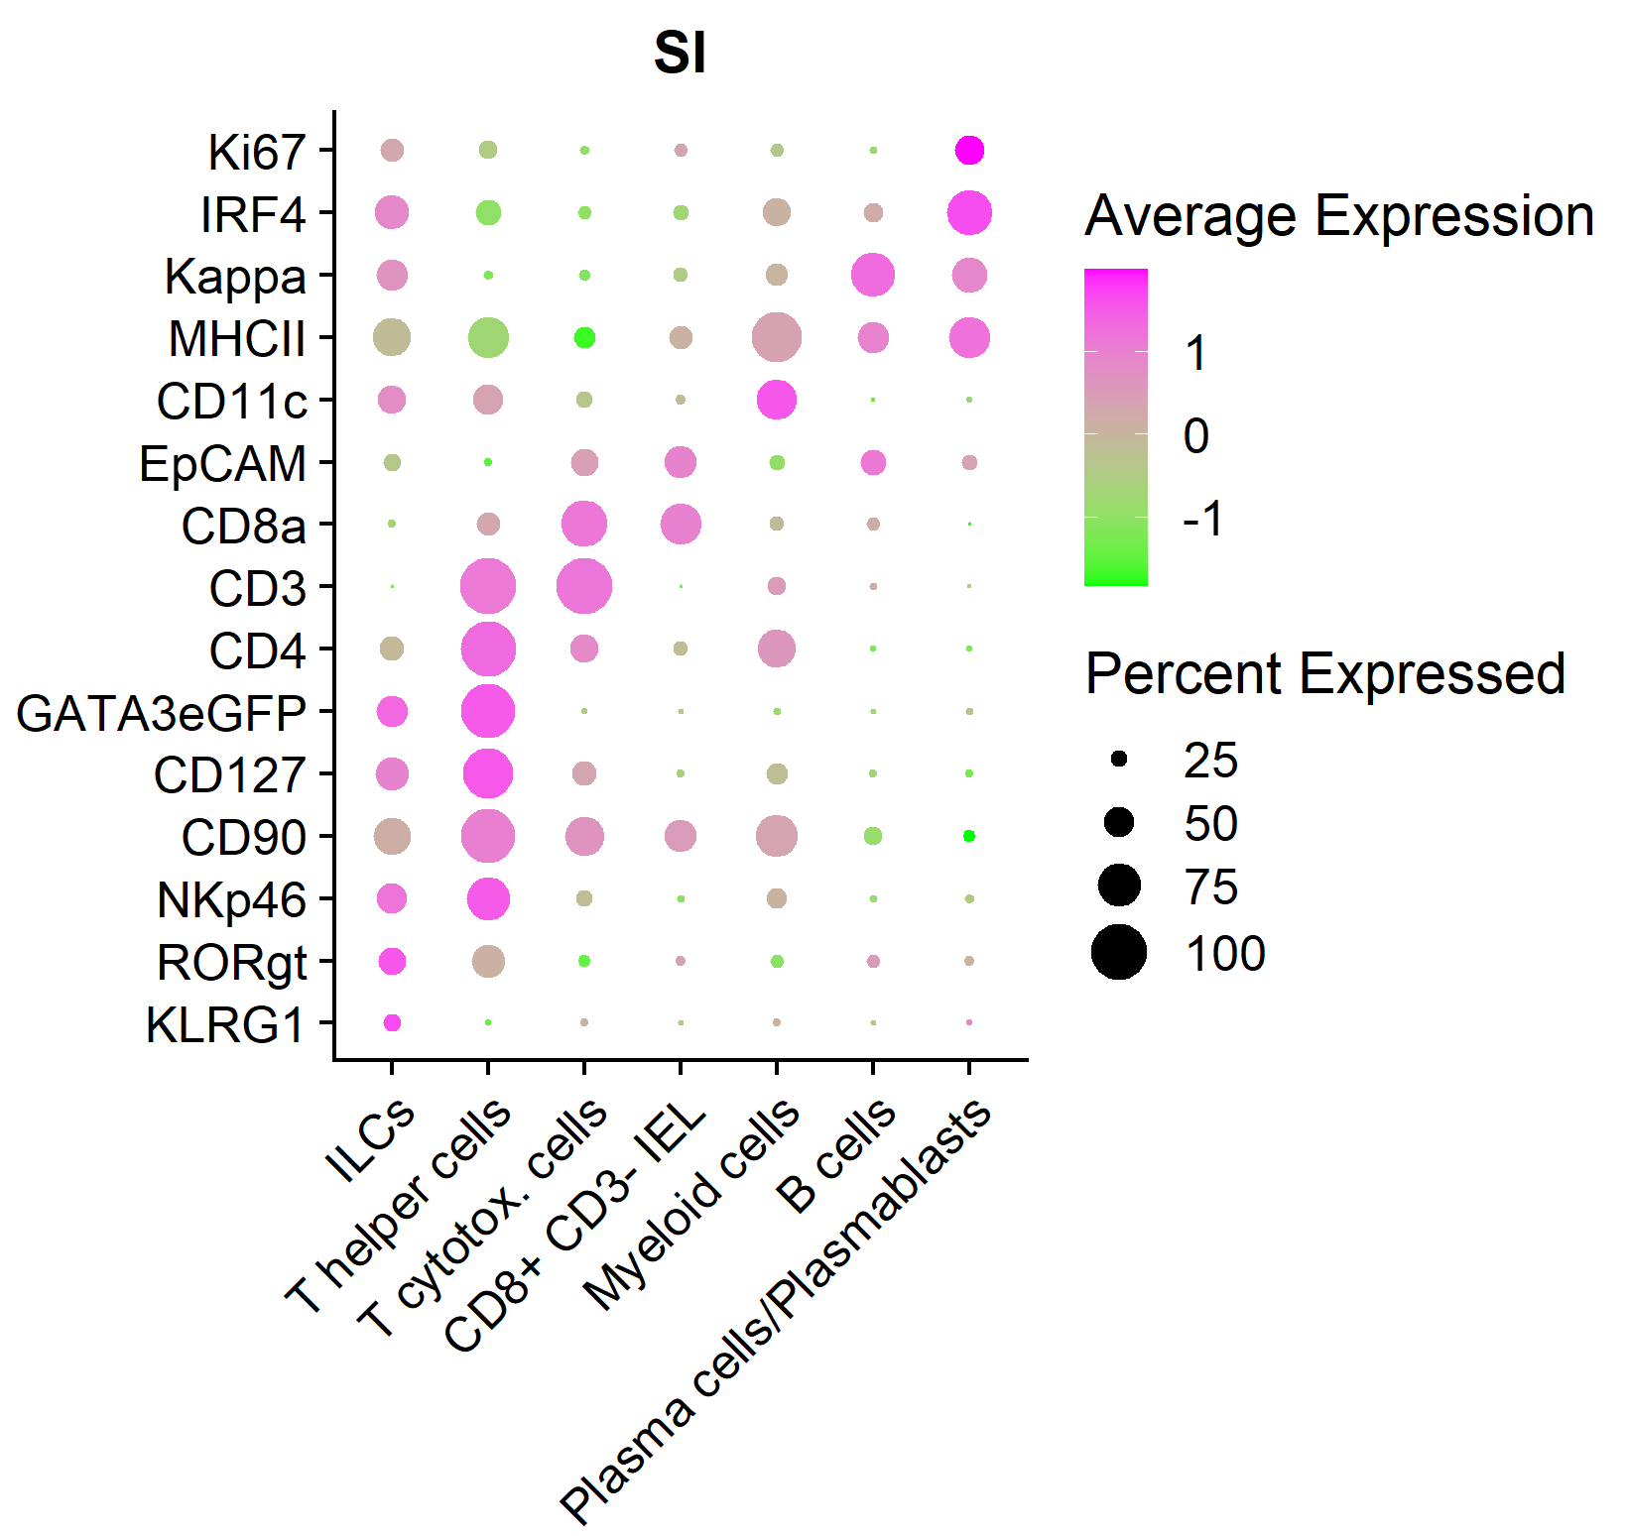
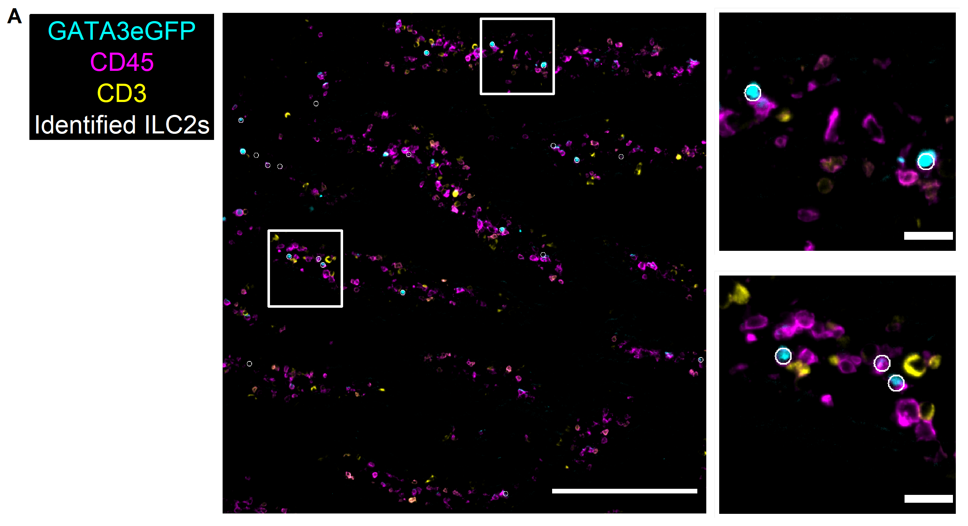
Figure 4: ILC2s and a mixed cluster of NK cells/ILC1s/ILC3s are resolved in murine SI tissue.
Figure 4: (A) Density plot showing the strategy to resolve ILCs and T cells in the SI data by applying a threshold on the CD3 intensity. (B) Dot plot showing the marker profiles of the annotated immune cell types in the SI including separated clusters for ILCs, T cytotox. cells and T helper cells. (C) Ridge plots of markers used for annotation of ILC subtypes in the SI. (D) Visual validation of annotated ILC2s (White circles) using IF overlays. Cells annotated as ILC2s are overlayed with GATA3eGFP (Cyan), CD45 (Magenta), and CD3 (Yellow). Identified cells are depicted as white circles, each circle representing one cell. White boxed mark regions of interest that are zoomed in respectively on the right side. Scale bars represent 200 µm in overviews, and 20 µm in ROIs.

Slide 10
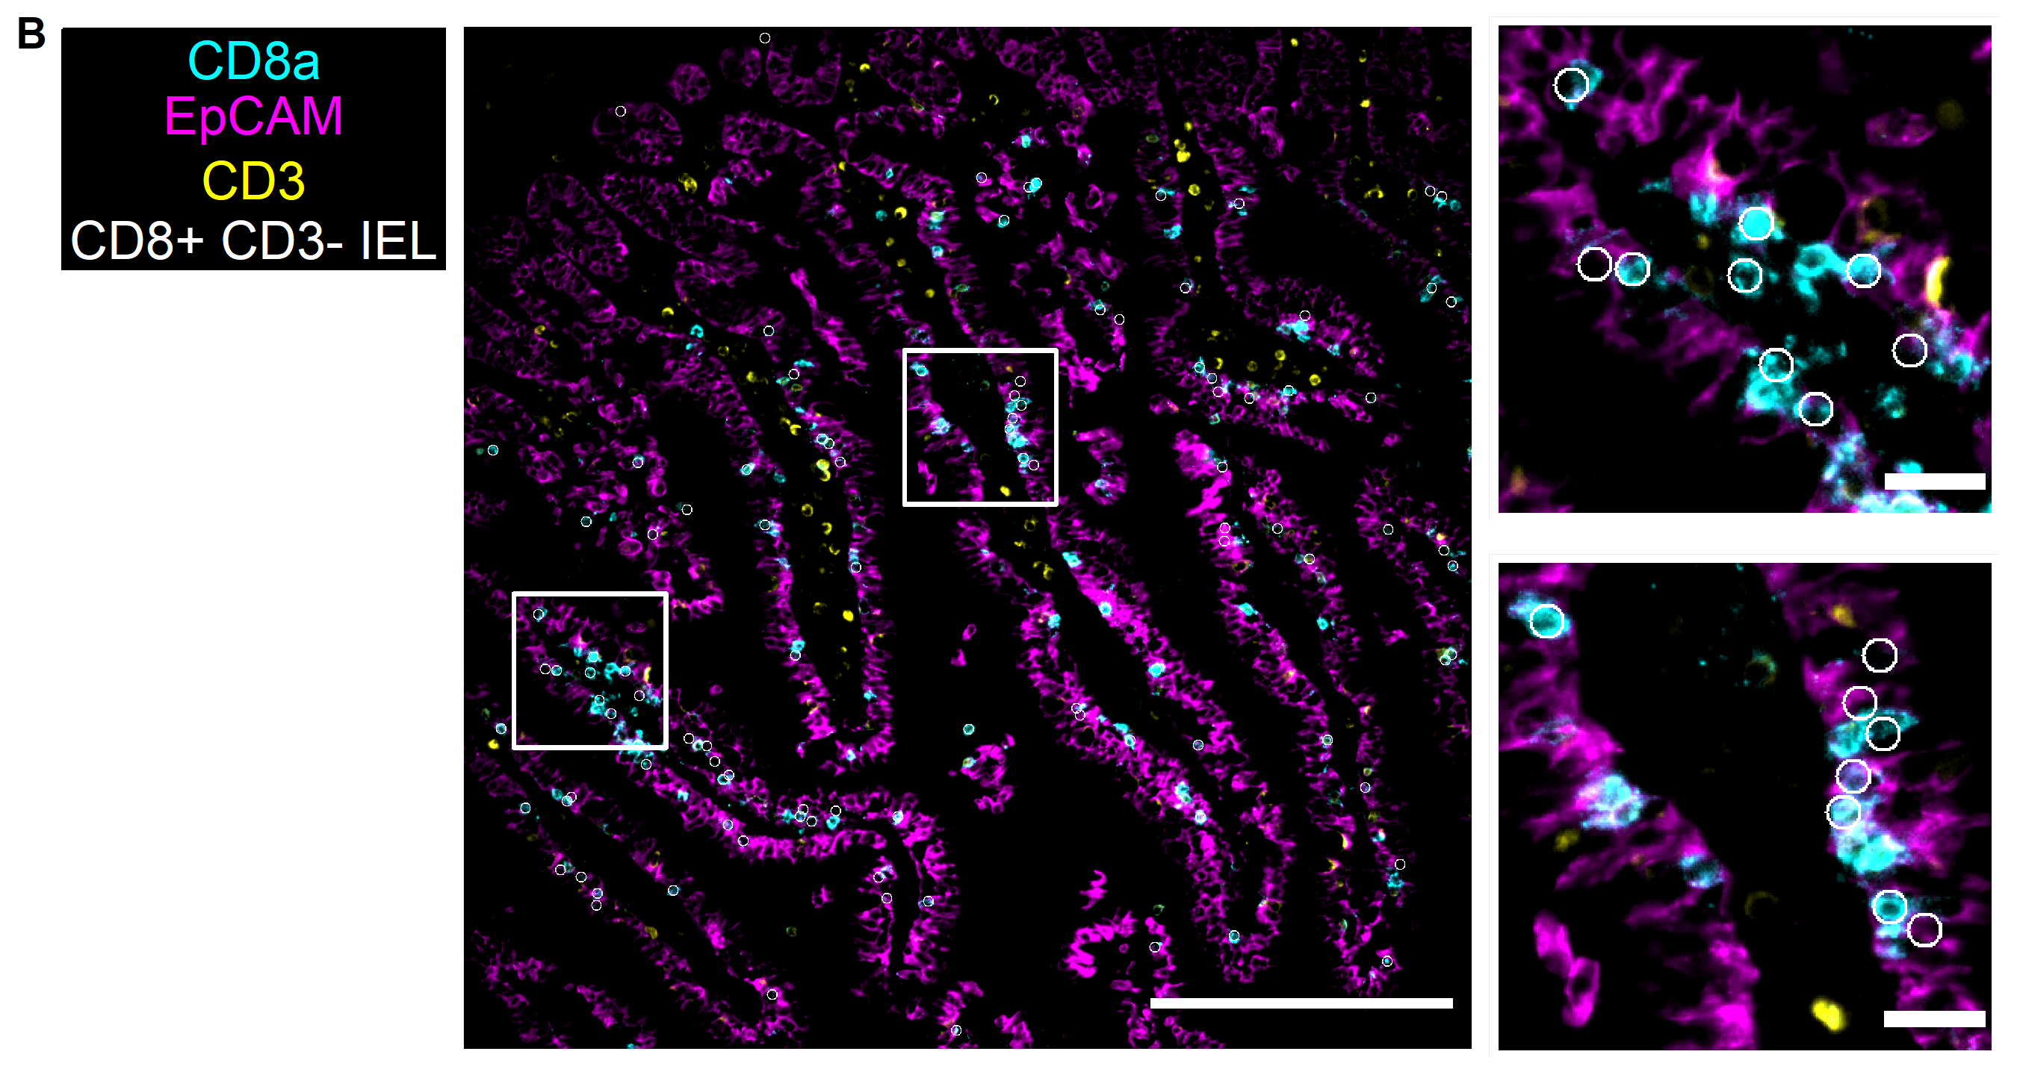
Supplementary figure 2: Visual inspection reveals cells of the CD8a+ CD3- cluster to be intra-epithelially.
Suppl. Figure 2: (A) Visual inspection revealed an intraepithelial location of CD8a+ CD3- cells (White circles) using IF overlays. CD8a (Cyan), EpCAM (Magenta), and CD3 (Yellow) are overlayed and identified cells are depicted as white circles, each circle representing one cell. White boxes mark regions of interest that are zoomed in respectively on the right side. Scale bars represent 200 µm in overviews, and 20 µm in ROIs.

Slide 11
Figure 5: ILC2 frequency already increases at IL-33 day 1 in the SI, while lung ILC2s only increase at IL-33 day 3.
Figure 5: (A) Boxplots depicting the cell count per field of view (FOV), ILC frequency of total cells, and ILC frequency within the immune cell compartment for each analyzed tissue type, namely lung, SI villi, SI ILF. (B) Stacked bar plot showing the proportion of the identified ILC subtypes within all identified ILCs of the analyzed tissue types lung, SI villi, and SI ILF. (C) Box plots visualizing the frequency of immune cells per FOV in lung and SI villi regions per condition time point, as well as the frequency of ILCs within the immune compartment. (D) Box plots depicting ILC frequencies at different condition time points in lung and SI villi. (E) Ridge plots visualizing the mean fluorescence intensity of Ki67 for lung ILC2s and NK cells/ILC1s. Box plots visualizing the frequency of the Ki67+ subset of lung ILC2s and NK cells/ILC1s. Each dot represents one analyzed FOV and is depicted as n at the top of each bar.
Notes:
Quantification of ILCs

Slide 12
Figure 6: Spatial analysis reveals accumulation of ILC2s in peri-lymphatic niches shared with myeloid cells in lung and SI.
Figure 6: (A) Bar plot depicts co-enrichment analysis of lung ILC2s and lymphatics. (B) IF overlay of markers for lymphatic endothelial cells LYVE1 (Cyan) and CD90.2 (Magenta) are shown together with analyzed ILC2s (White dots) and lymphatics (Yellow dots) in an exemplary tissue region in the lung at IL-33 day 2. (C) Box plots showing the minimal distance in µm of different identified immune cell types to lymphatics under homeostatic conditions (CTRL, left) and after 3 doses of IL-33 (D3, right). (D) Bar plot showing the results of the co-enrichment analysis of ILC2s with lymphatics and fibroblasts in SI villi and SI ILF tissue regions. (E) IF overlays of FN (Cyan), PDPN (Magenta), and LYVE1 (Yellow) depicted with identified ILC2s (White dots) in SI villi (left) and SI ILF (right) exemplary tissue regions. (F) Bar plot showing the co-enrichment scores of ILC2s and ILC2s in lung, SI villi and SI ILF tissue regions. (G) Boxplots depicting the frequency of ILC2s in a 10 µm radius around ILC2s in lung, SI villi and SI ILF tissue regions. (H) Bar plot showing the co-enrichment scores of ILC2s and myeloid cells in lung, SI villi and SI ILF tissue regions. (I) Boxplots depicting the frequency of myeloid cells in a 10 µm radius around ILC2s in lung, SI villi and SI ILF tissue regions. In bar plots, each bar represents one analyzed field of view (FOV). In IF overlays, scale bar represents 200 µm.

Slide 13
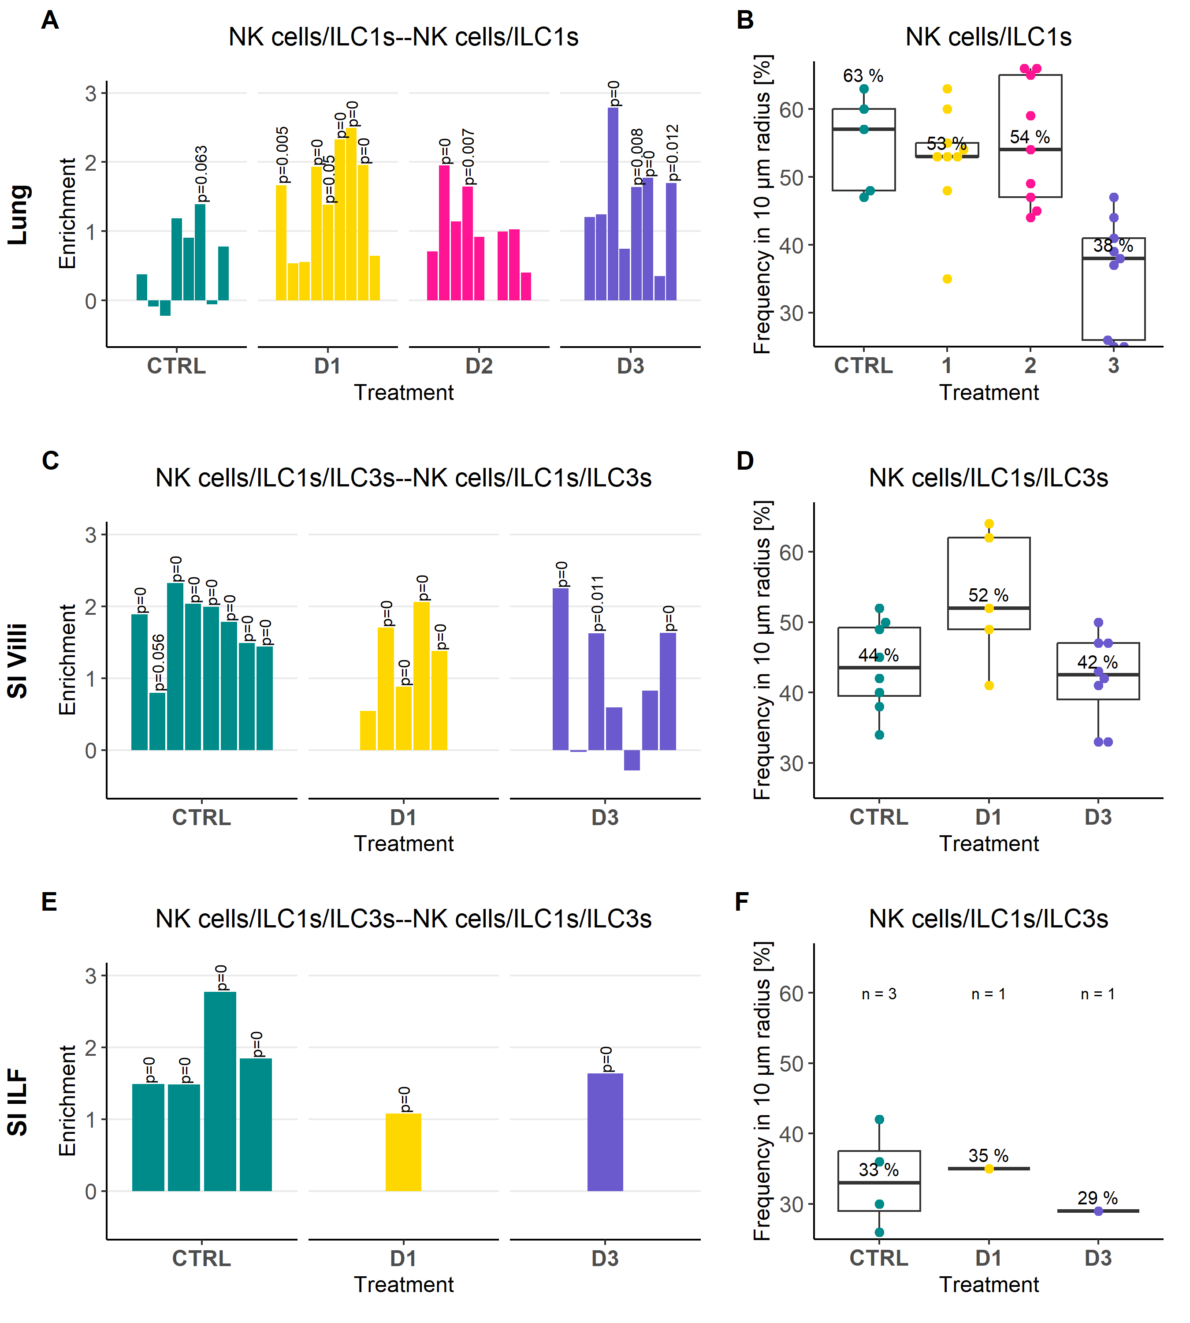
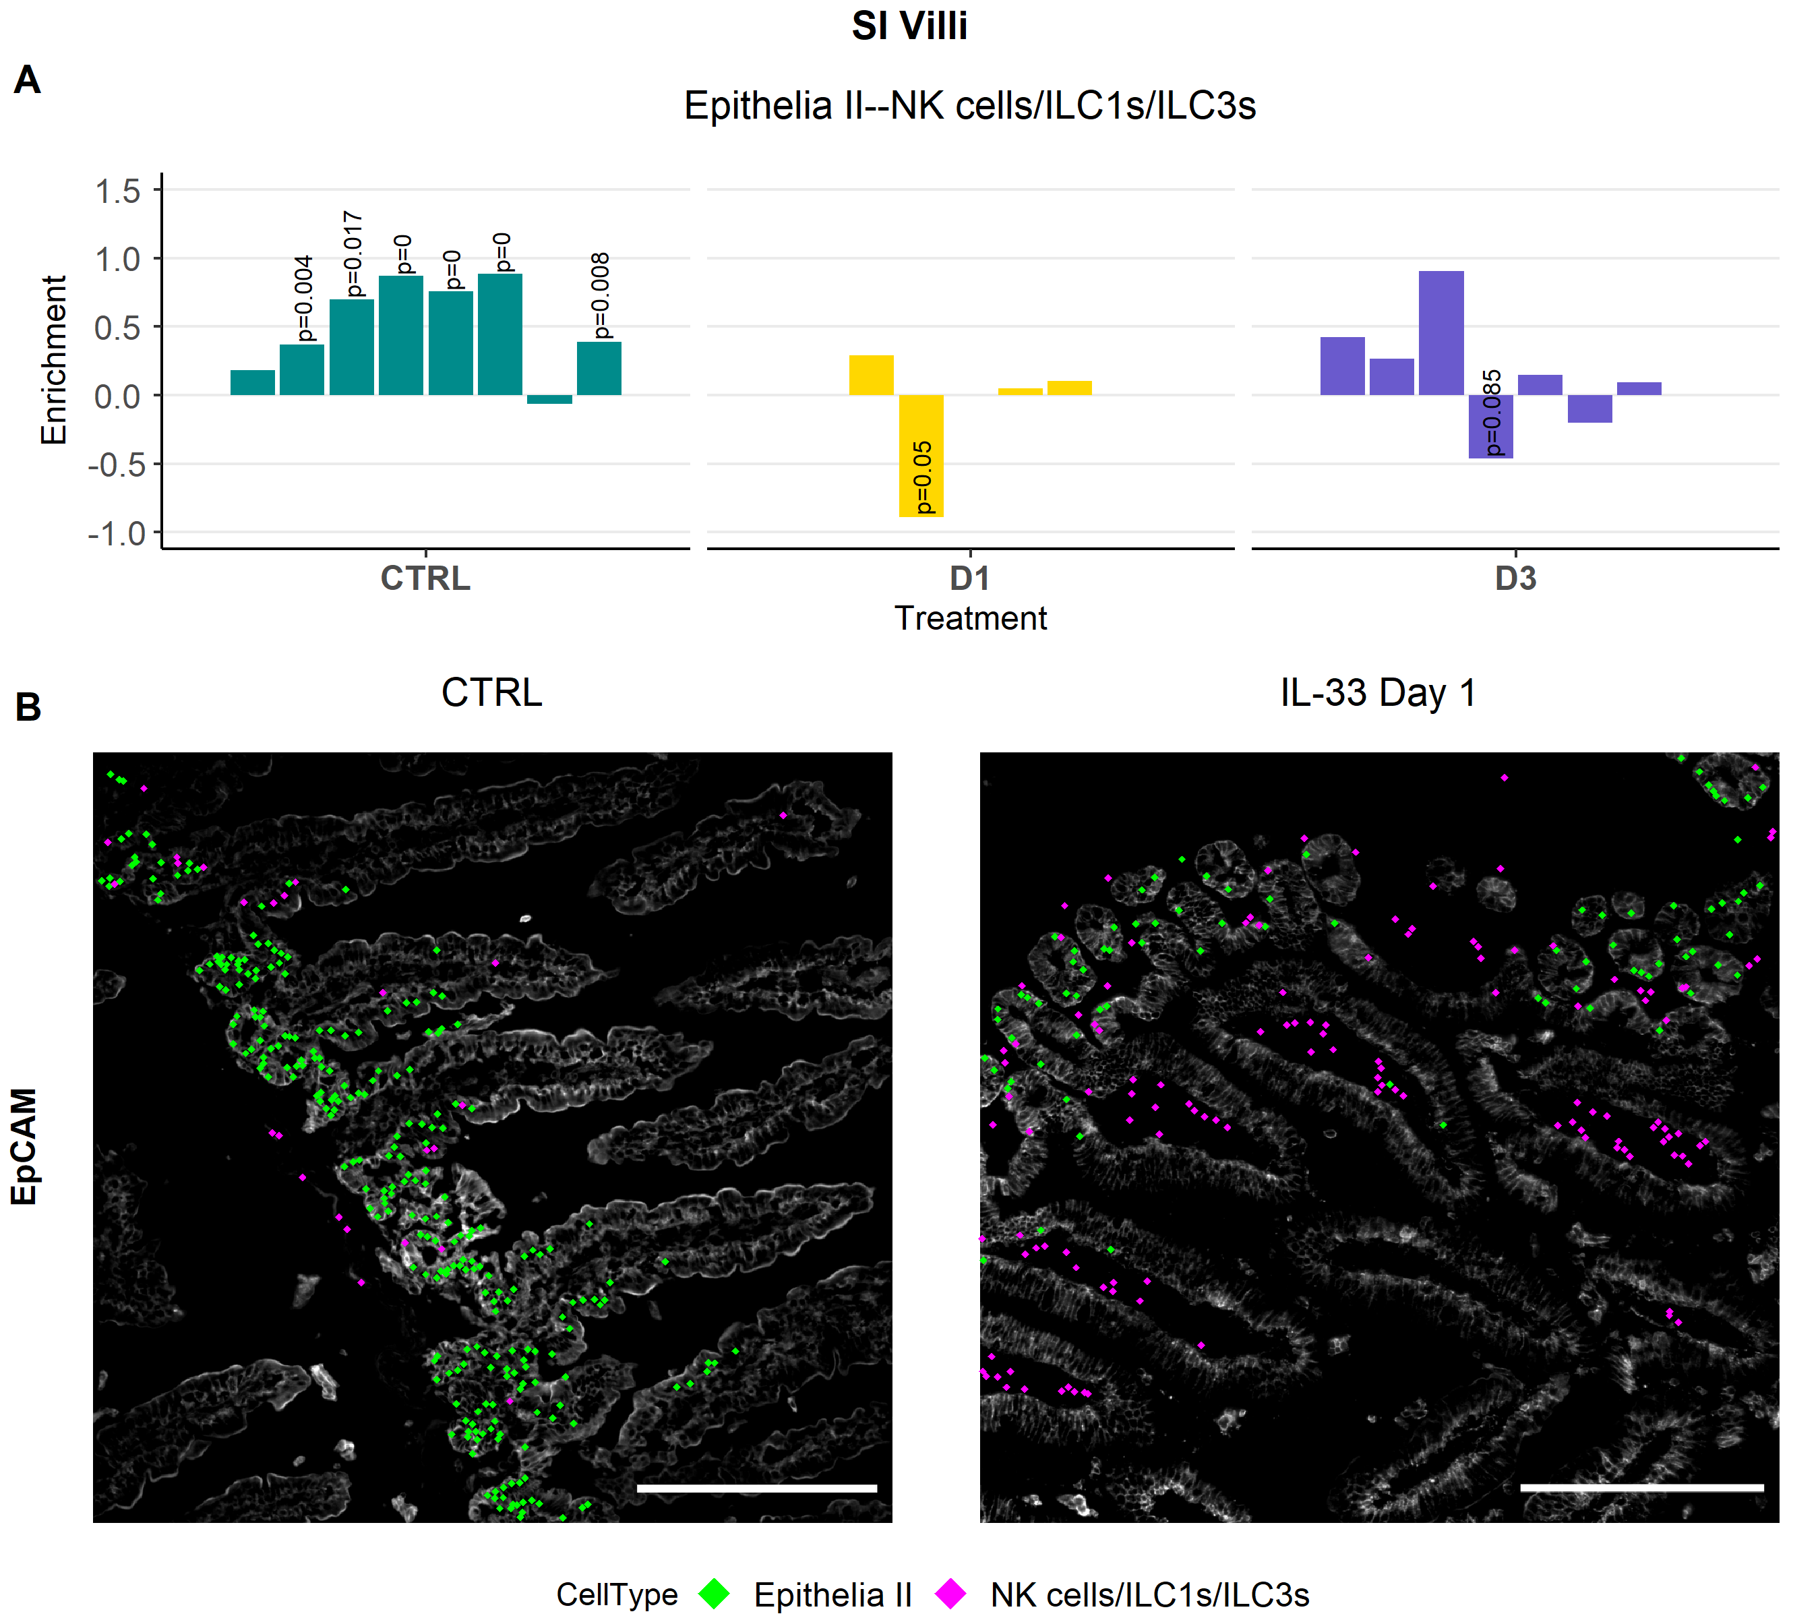
Figure 7: Lung NK cells/ILC1s and intestinal NK cells/ILC1s /ILC3s accumulate in peri-vascular tissue areas.
Figure 7: (A) Bar plot depicts co-enrichment analysis of NK cells/ILC1s with NK cells/ILC1s in the lung, as well as NK cells/ILC1s/ILC3s with NK cells/ILC1s/ILC3s of the SI villi and SI ILF. Each bar represents one analyzed FOV. (X) Bar plots showing the co-enrichment analysis results of NK cells/ILC1s/ILC3s with cells of the epithelia II cluster in SI villi regions at different condition time points. (X) Immunofluorescence staining of EpCAM (White) depicted with cells of the cluster NK cells/ILC1s/ILC3s (Magenta) and epithelia II cluster (Green) as dots.
Notes:
Also show here the enrichment score plots of the NK cells/ILC1s/ILC3s with blood vessels and the minimal distance plots and IF overlays?

